Slide 1
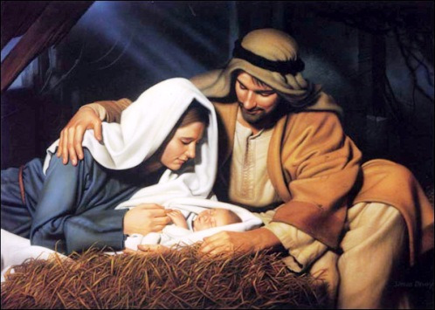
God’s Christmas Gift to us

Slide 2
Consequences of Adam’s Sin
We are born under the curse of sin (Rom. 5)
All have sinned and come short of the glory of God (Rom. 3:23)
There is no one righteous, not even one (Rom. 3:10)
The wages of sin is death (Rom. 6:23)

Slide 3
The Greatest Gift Ever Given
Jesus was born to be the Savior of the world
God poured out the punishment for our sins on His own Son
God gave us freedom from the power of sin, and He gave us eternal life

Slide 4
1. The Gift Foretold

Slide 5
“Therefore, the Lord Himself shall give you a sign; Behold, a virgin shall conceive, and bear a son, and shall call his name Immanuel.” (Isa. 7:14)
“For unto us a child is born, unto us a son is given: and the government shall be on his shoulder: and His name shall be called Wonderful, Counselor, The mighty God, The everlasting Father, The Prince of Peace.”(Isa. 9:6)

Slide 6
2. The Gift of Forgiveness
It is only through Jesus that we are forgiven
We are redeemed by the blood of Jesus, and through Him we receive forgiveness for our sins (Eph. 1:7)
Our sins have been forgiven for His name’s sake (I Jn. 2:12)

Slide 7
3. The Gift Forgotten
Mary sat down to listen to Jesus, but Martha was distracted by all the preparations (Lk. 10)
There are a growing number of people who are against anyone celebrating the birth of Jesus
“Wimpy pastors produce wimpy Christians and that’s why we’re losing this culture war.” – Dr. Robert Jeffress

Slide 8
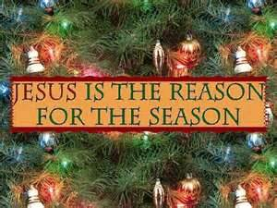
Merry Christmas!

