Slide 1
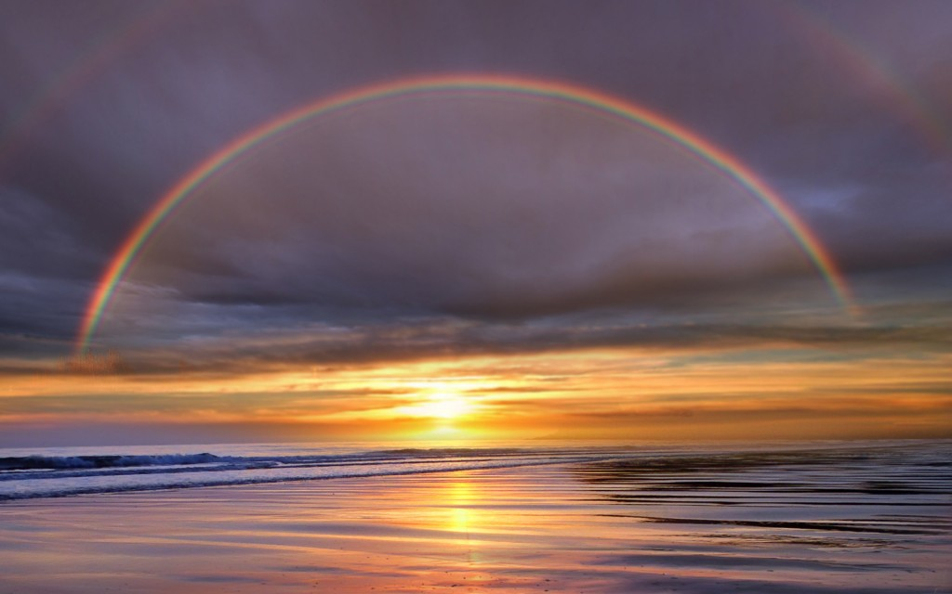
Set Your Eyes on Eternity

Slide 2
1. Built to Last

Slide 3
“ Surely God would not have created such a being as man to last only for a day! No, man was made for immortality.”
Abraham Lincoln

Slide 4
Ecclesiastes 3:11
“God has planted eternity in the human heart.”

Slide 5
2 Corinthians 5:1
“For we know that when this earthly tent we live in is taken down, we will have a house in heaven, an eternal body made for us by God Himself and not by human hands.”

Slide 6
Psalm 33:11
“God’s plans endure forever; His purposes last eternally.”

Slide 7
2. Through the Eyes of God

Slide 8
Life is a Test
“God will not allow you to be tempted beyond your power to remain firm; at the time you are put to the test, He will give you the strength to endure it, and so provide you with a way out.”
(I Corinthians 10:13)

Slide 9
Life is a Test
“God blesses those who patiently endure testing and temptation. Afterward they will receive the crown of life that God has promised to those who love Him.” (James 1:12)

Slide 10
Life is a Trust
“The earth is the Lord’s, and everything in it. The world and all its people belong to Him.”
(Psalm 24:1)

Slide 11
Life is a Trust
“Those who are trusted with something valuable must show they are worthy of that trust.” (I Cor. 4:2)

Slide 12
Rewards for the Trustworthy
You will receive God’s Affirmation
You will receive a Promotion
You will be honored with a Celebration

Slide 13
Luke 12:48
“When someone has been given much, much will be required in return; and when someone has been entrusted with much, even more will be required.”

Slide 14
Life is a Temporary Assignment
“If you call God your Father, live your time as temporary residents on earth.” (I Peter 1:17)

Slide 15
Life is a Temporary Assignment
“We fix our eyes not on what is seen, but on what is unseen. For what is seen is temporary, but what is unseen is eternal.”
(2 Corinthians 4:18)

Slide 16
3. Glorifying God

Slide 17
Psalm 19:1
“The heavens declare the glory of God.”

Slide 18
How Can I Bring Glory to God?
Worshipping Him
Loving Other Believers
Becoming Like Jesus Christ
Serving Others with our Gifts
Telling Others about Him

Slide 19
Who Are You Going to Live For?
“To all who received Him, to those who believed in His Name, He gave the right to become children of God.” (John 1:12)

