Slide 1
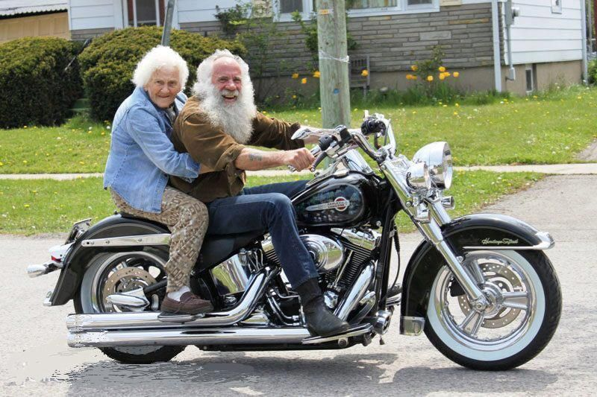
Life More Abundantly

Slide 2
It’s NOT All About Me
The abundant life comes from focusing on God; not ourselves
“Through Him everything in heaven and earth was created. He made the visible and the invisible. All things were created by Him and for Him” (Col. 1:6)

Slide 3
Produced for a Purpose
Children may come as a surprise to their parents, but they never come as a surprise to God
Psalm 139 says God saw us before we were born and knew about every moment of our lives
God made us because He loves us (Eph.1:4-5)

Slide 4
Who’s Going to Drive?
Some are driven by Guilt
“What happiness for those whose guilt has been forgiven!...What relief for those who have confessed their sins and God has cleared their record.” (Ps. 32:1)

Slide 5
Who’s Going to Drive?
Some are driven by Resentment & Anger
Resentment always hurts YOU more than the person you resent
“Resentment kills the foolish man.” (Job 5:2)

Slide 6
Who’s Going to Drive?
Some are driven by Fear
“There is no fear in love: true love has no room for fear, because where fear is, there is pain; and he who is not free from fear is not complete in love.” (I Jn. 4:18)

Slide 7
Who’s Going to Drive?
Some are driven by Materialism
Having more money does NOT make you more secure
Real security can only be found in your relationship with God

Slide 8
Let’s Start Living
Living for God gives MEANING to your life
Living for God SIMPLIFIES your life
Living for God FOCUSES your life
Living for God MOTIVATES your life
Living for God prepares you for ETERNITY

Slide 9
2 Questions From God
“What did you do with my Son, Jesus Christ?”
“What did you do with what I gave you?”
The first question determines where you will spend eternity; the second determines what you will do in eternity

