Slide 1
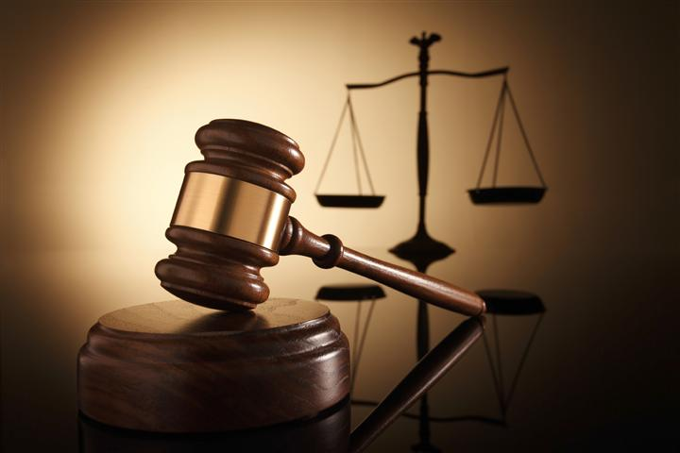
The Judgment of God(Part II)
Part III

Slide 2
Comparing False Teachers to…
“The Way of Cain”
His offering was rejected because of the attitude of his heart
He believed he could come to God by his own merit

Slide 3
Comparing False Teachers to…
“Balaam’s error”
God would not allow him to curse Israel
He was more interested in money than in doing the Lord’s will
His plan led the Israelites to worship false gods

Slide 4
Comparing False Teachers to…
“Korah’s rebellion”
He led a rebellion against God’s chosen authority
These false teachers rejected the authority of Jesus and His apostles

Slide 5
Exposing the Truth about False Teachers
They are shepherds who only care for themselves
They make great promises, but only deliver disappointment
They stir up trouble and spiritual garbage

Slide 6
The Prophecy of Enoch
He spoke of God’s coming judgment
He never experienced physical death
His experience shows us a picture of the Rapture of the Church

Slide 7
Fault Finders
They are unwilling to get involved in the work of the Church
They are quick to point out why everyone else is wrong
They believe they have the “spiritual gift” of criticism

Slide 8
Following Evil Desires
They are shepherds who “fleece the flock”
They brag about their accomplishments
Their preaching is motivated by money

Slide 9
Hebrews 4:12
“The Word of God is living and active. Sharper than any double-edged sword, it penetrates even to dividing soul and spirit, joints and marrow; it judges the thoughts and attitudes of the heart.”

