Slide 1
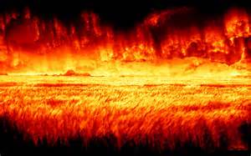
The Judgment of God
Part II

Slide 2
Examples of God’s Judgment
He judged the Israelites who rebelled against Him
He judged the angels who rebelled against Him
He judged the people of Sodom and Gomorrah

Slide 3
I Corinthians 6:18
“Flee sexual immorality. All other sins a man commits are outside his body, but he who sins sexually sins against his own body.”

Slide 4
False Teachers Reject Authority
They denied essential Biblical doctrines
They had no respect for the power of supernatural beings (angels and demons)
Do we really have preachers like this in our churches today?

Slide 5
Poll of 700 Pastors
48% denied that the Bible is the inspired Word of God
24% denied the Atonement
12% denied the resurrection of Jesus
27% do not believe in the return of Christ

Slide 6
Proverbs 16:5
“The Lord detests all the proud of heart. Be sure of this: They will not go unpunished.”

Slide 7
II Corinthians 11:13-14
“For such men are false apostles, deceitful workmen, masquerading as apostles of Christ. And no wonder, for Satan himself masquerades as an angel of light.”

Slide 8
A Word of Encouragement
Study your Bible on a regular basis
Become familiar with the truth
Teach your children to “Contend for the Faith”

