Slide 1
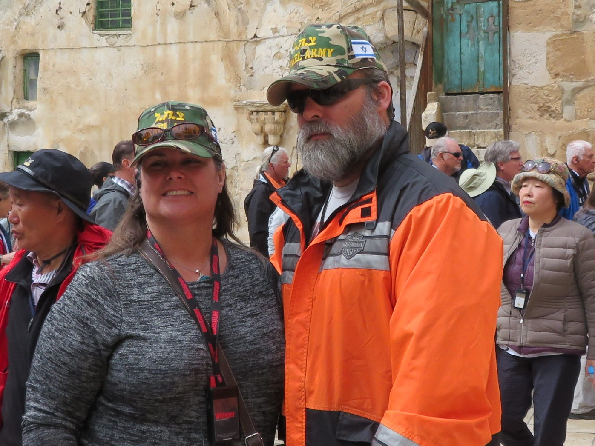
Exploring the Holy Land Part V

Slide 2
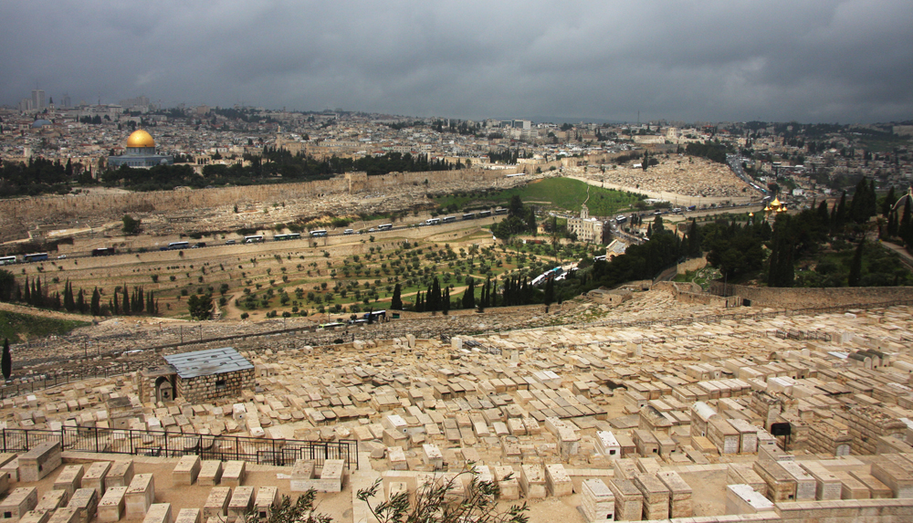
View from the Mt. of Olives

Slide 3
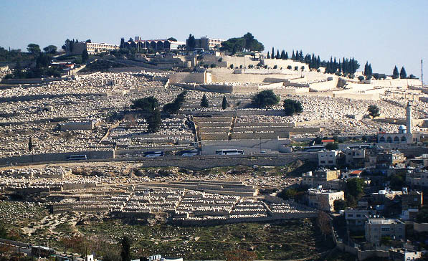
View from the Temple Mount

Slide 4
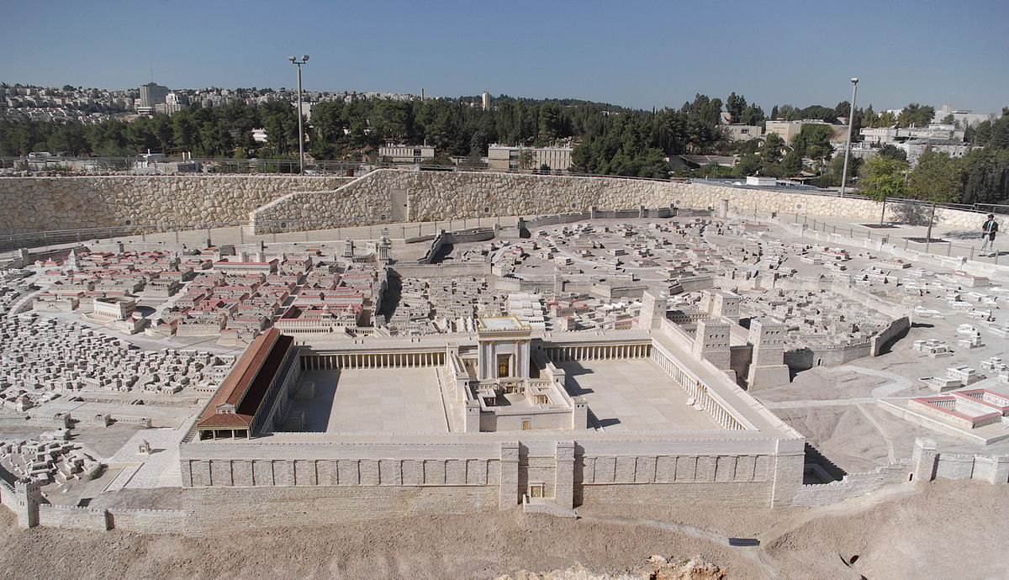
Model of Jerusalem (66 A.D.)

Slide 5
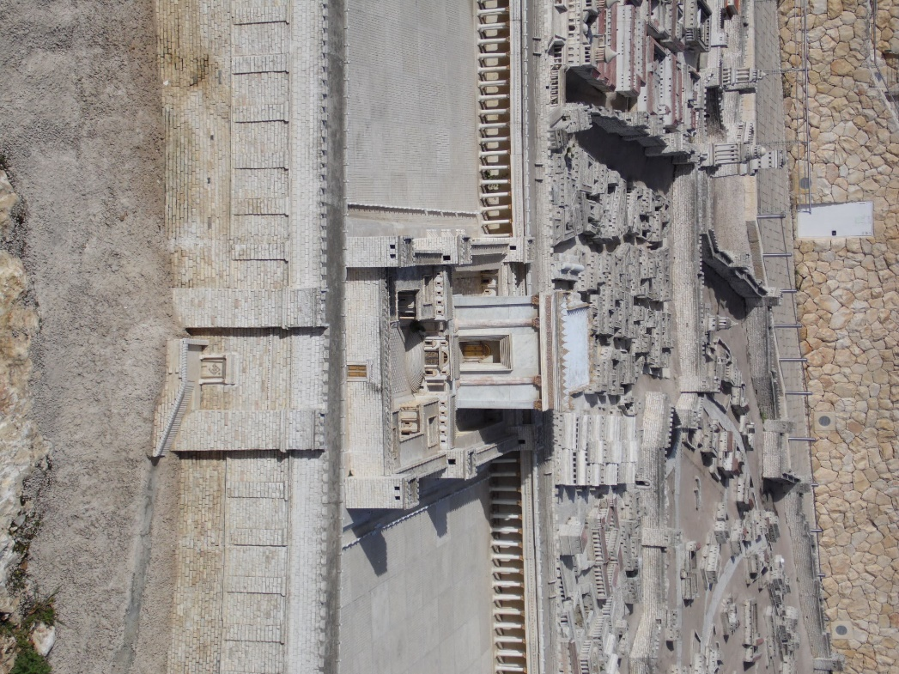
Model of Eastern Gate

Slide 6
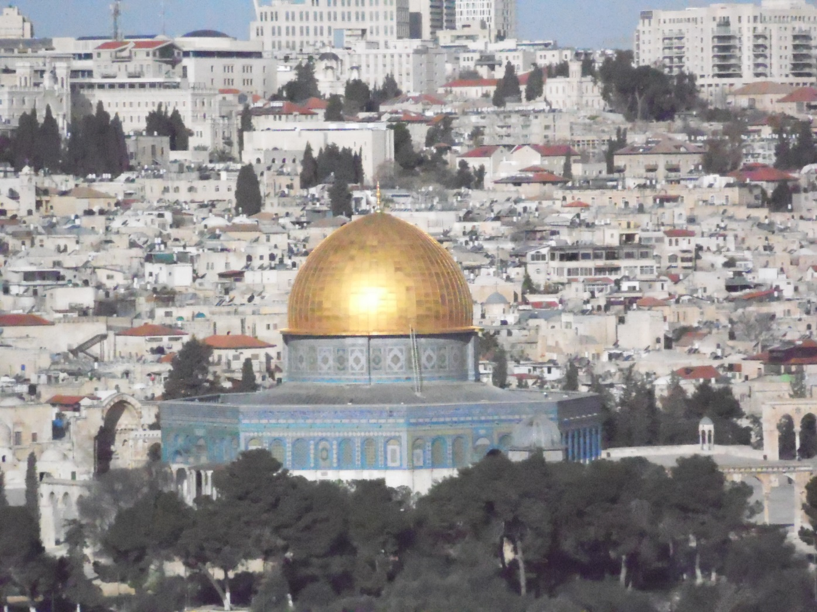
Dome of the Rock (On Temple Mount)

Slide 7
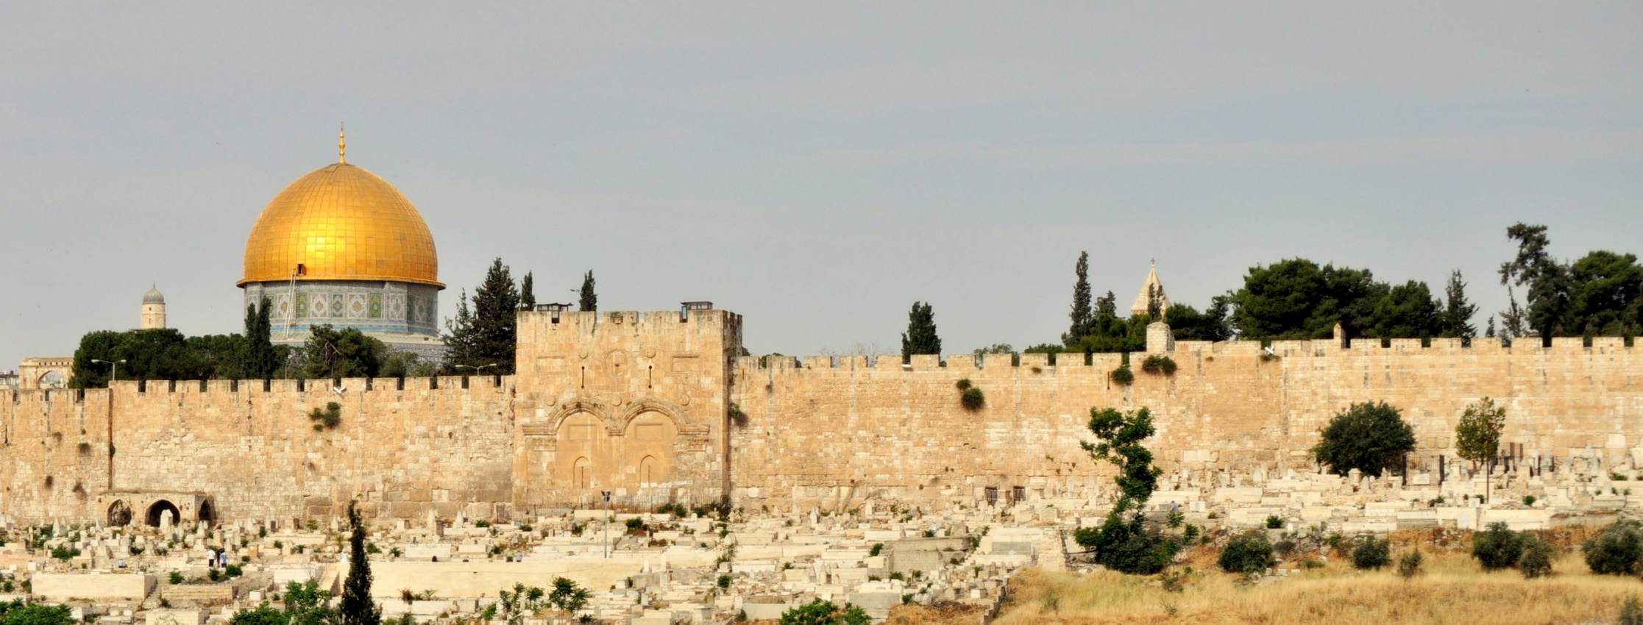
Eastern Gate

Slide 8
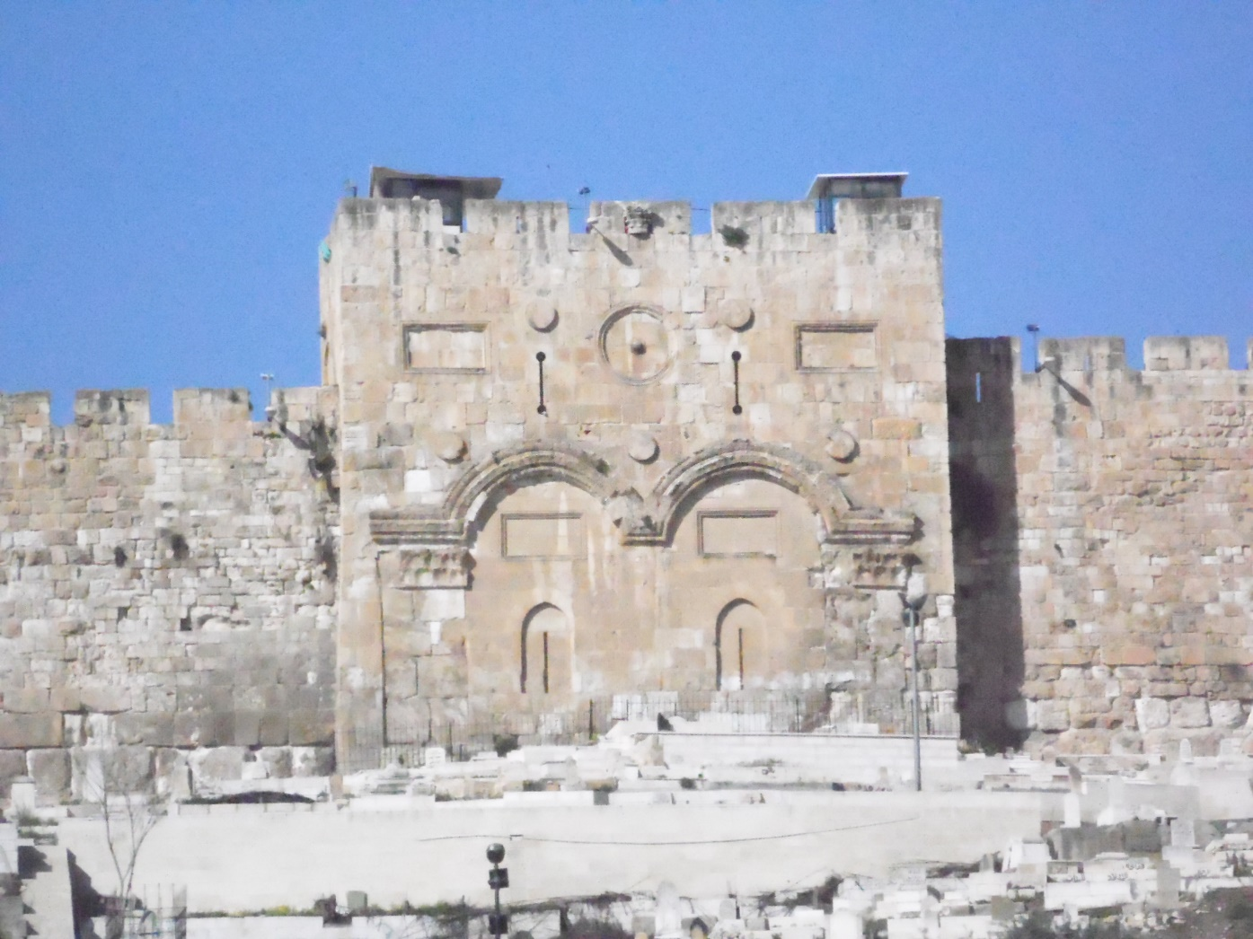
Eastern Gate

Slide 9
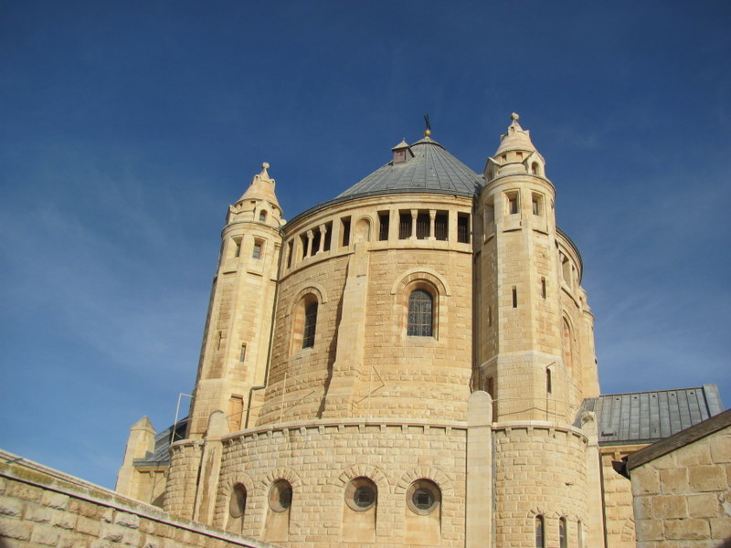
Traditional Location of the Upper Room

Slide 10
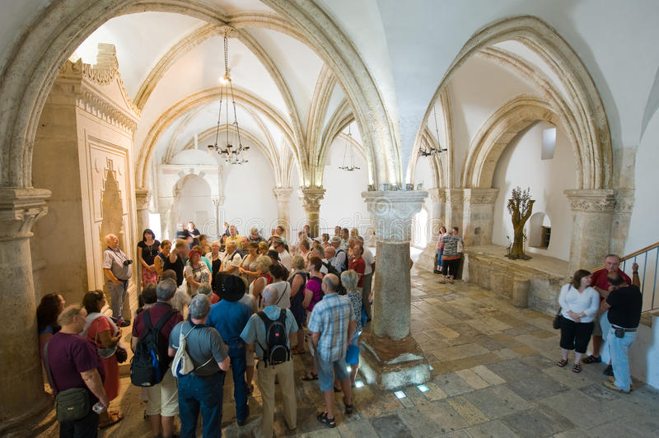
The Upper Room

Slide 11
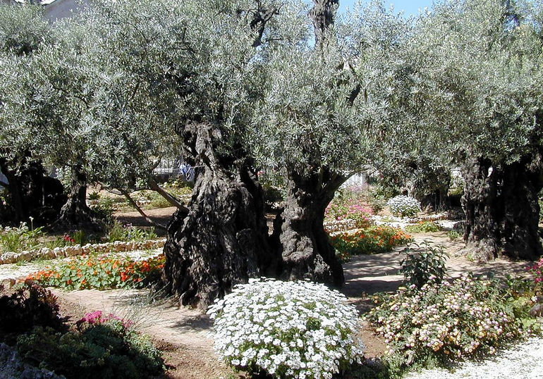
Garden of Gethsemane

Slide 12
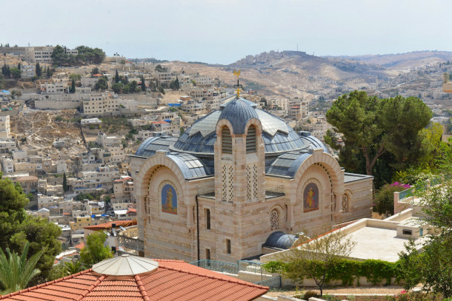
House of Caiaphas

Slide 13
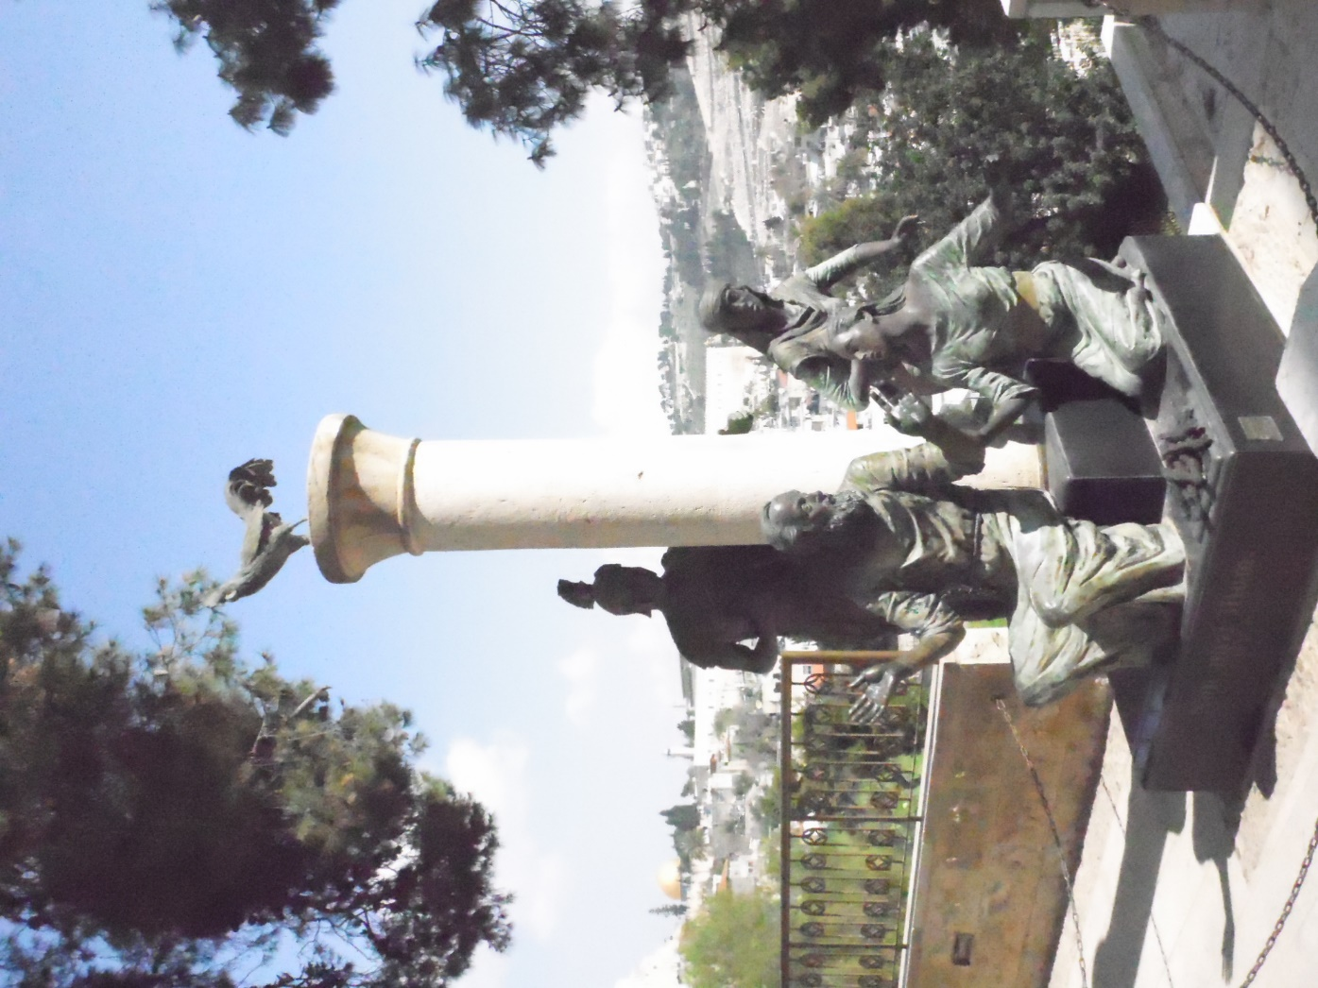
Peter’s Denial of Christ

Slide 14
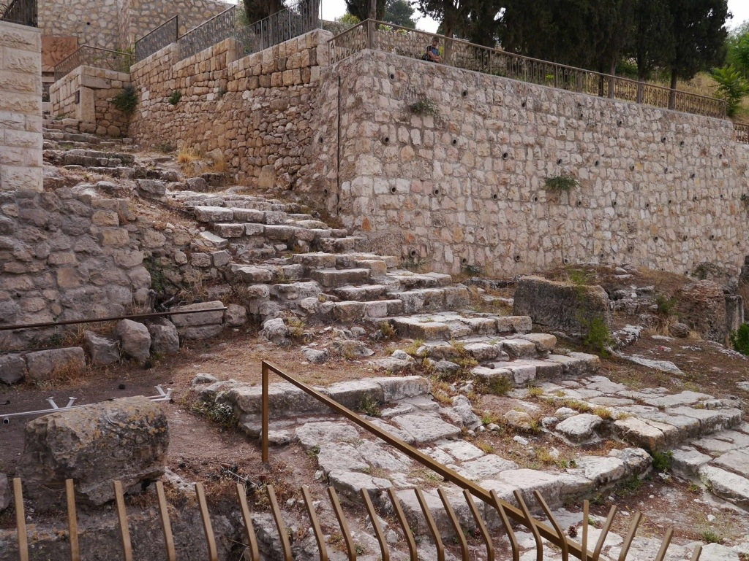
Steps from the time of Jesus

Slide 15
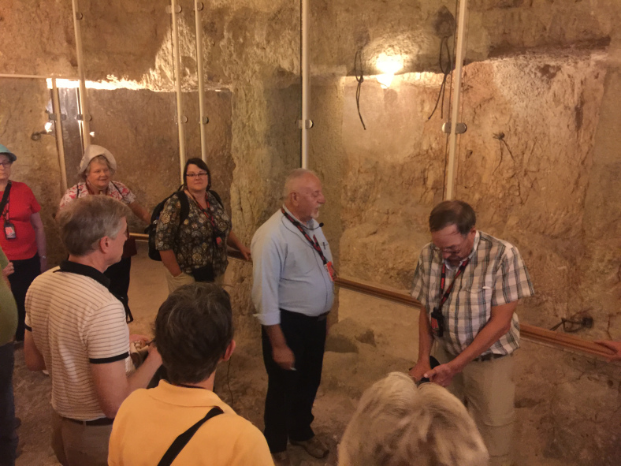
Dungeon at House of Caiaphas

Slide 16
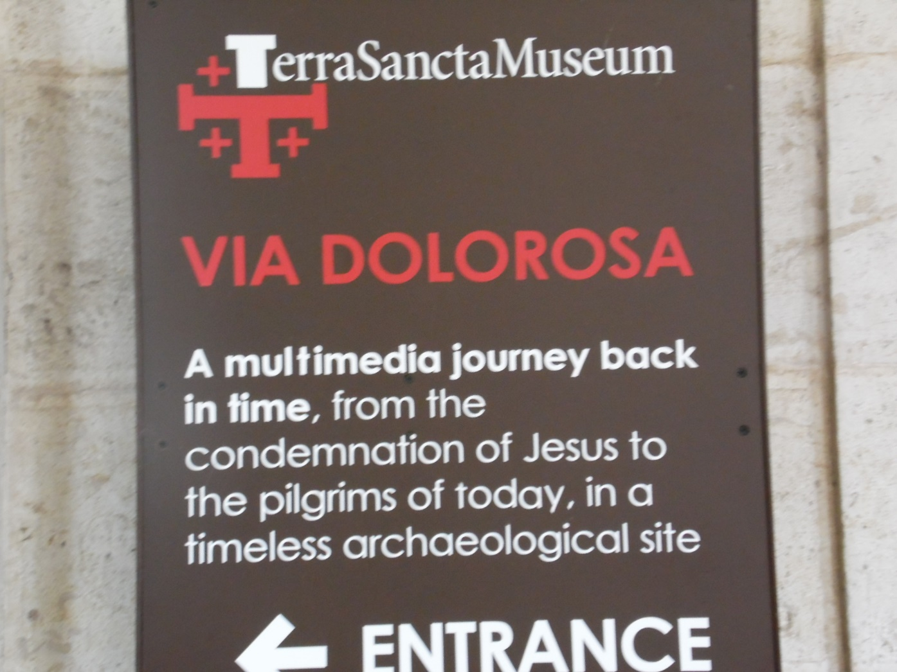

Slide 17
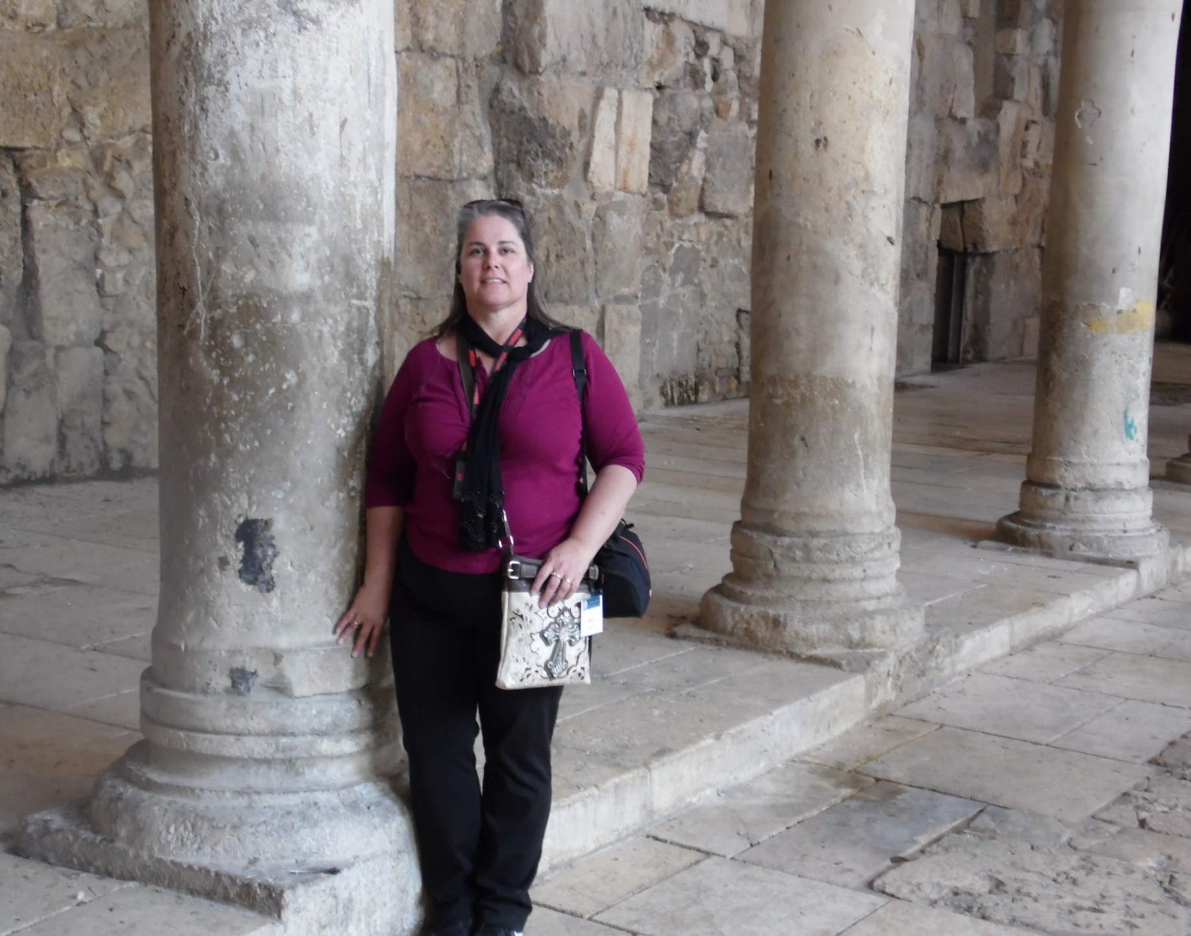
Shiela on the Via Dolorosa

Slide 18
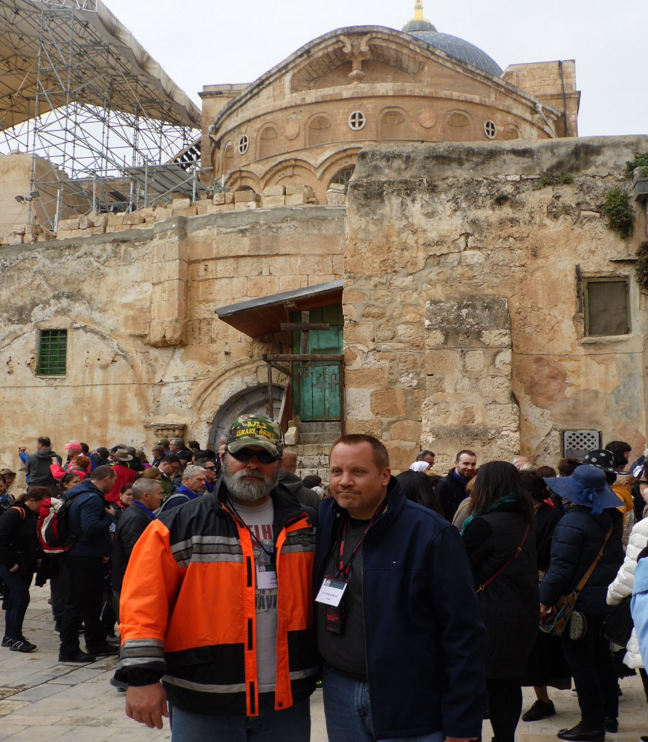
Golgotha/Calvary

Slide 19
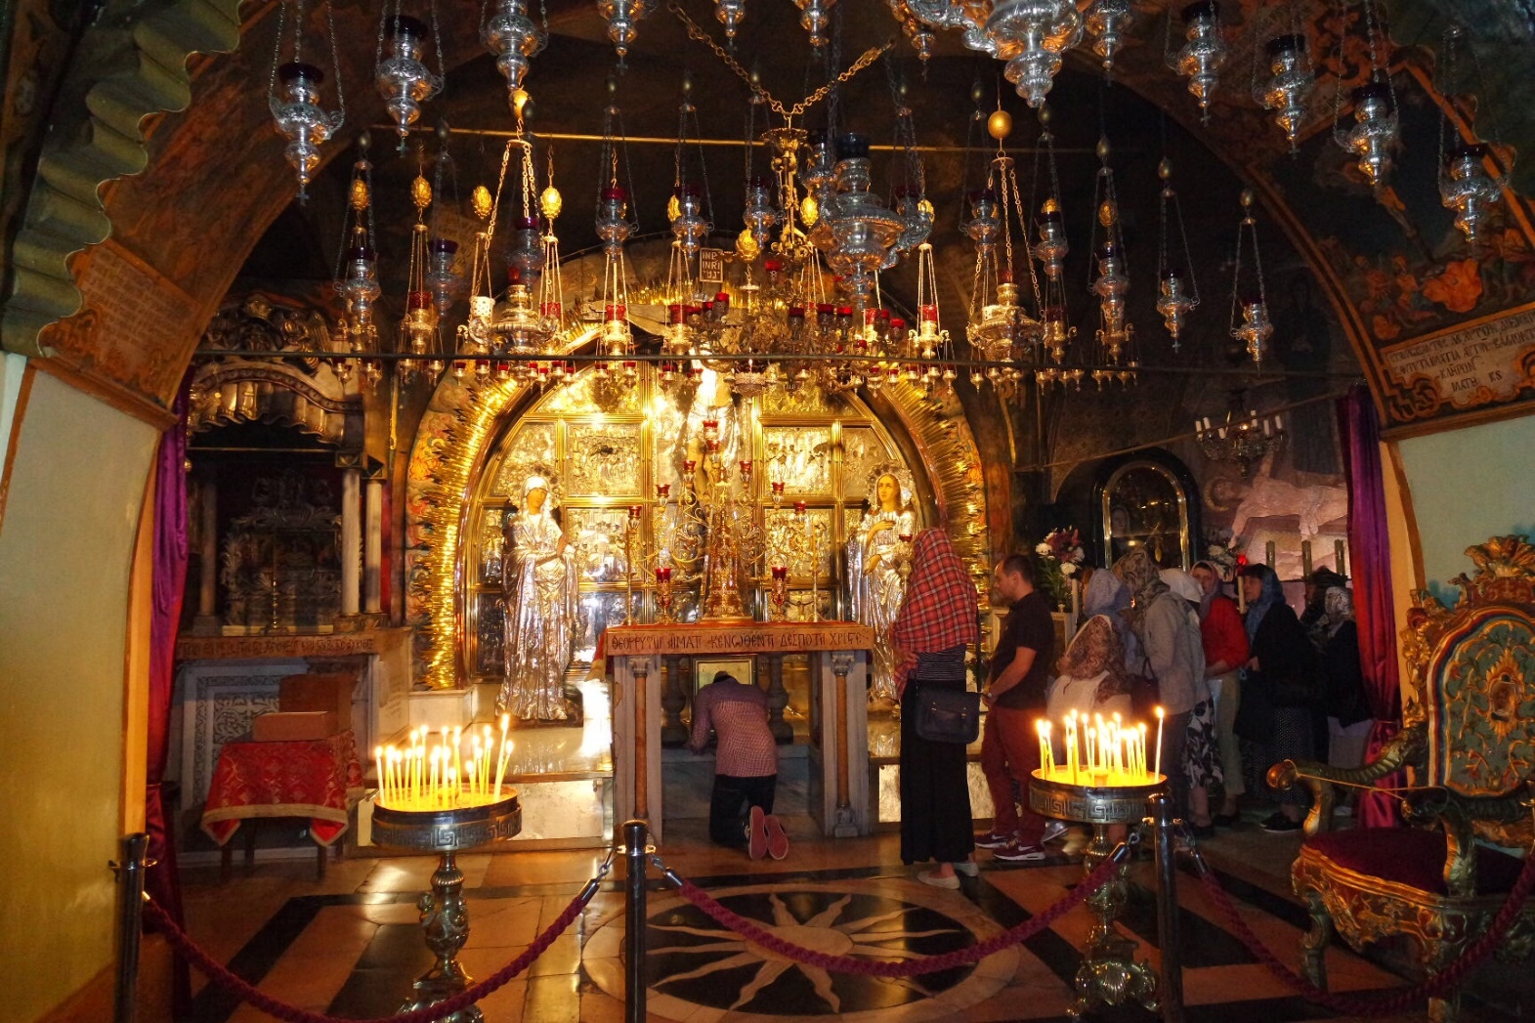
The Holy Sepulcher

Slide 20
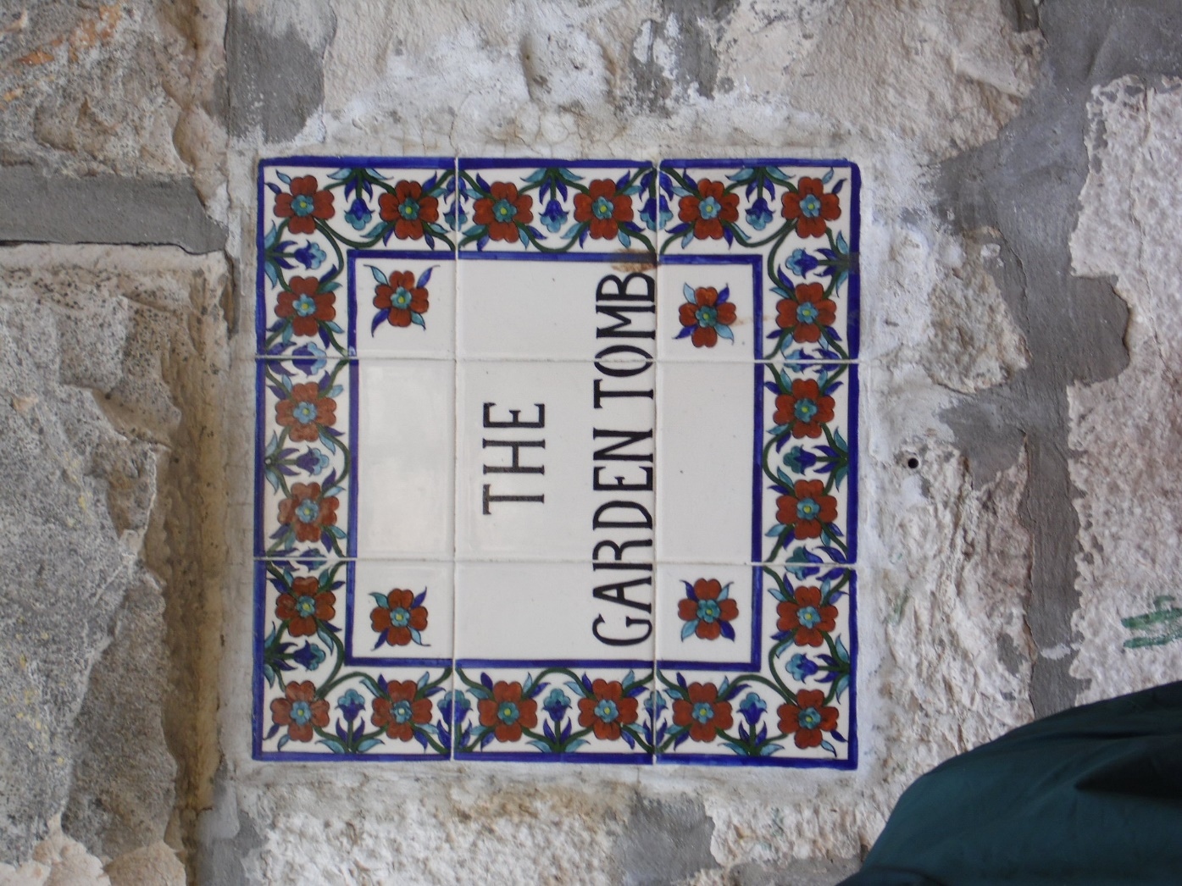

Slide 21
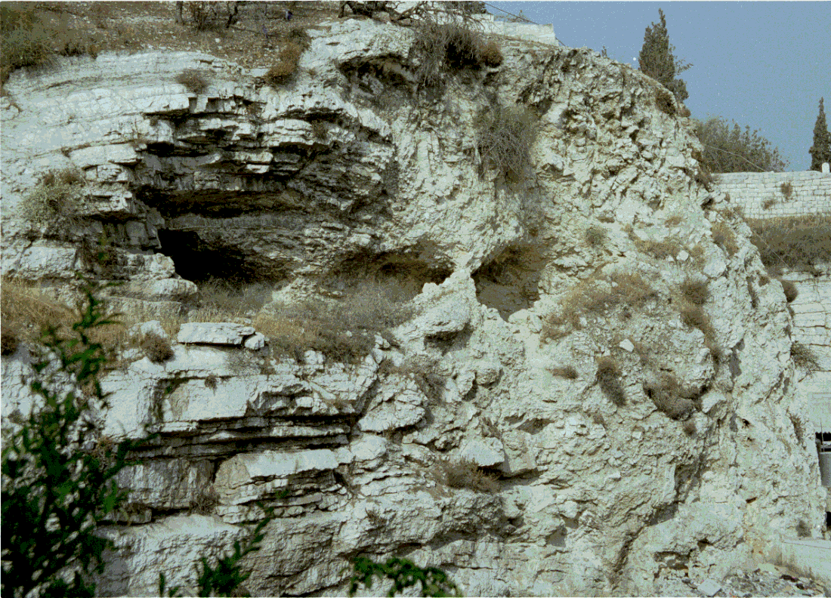
Skull Hill

Slide 22
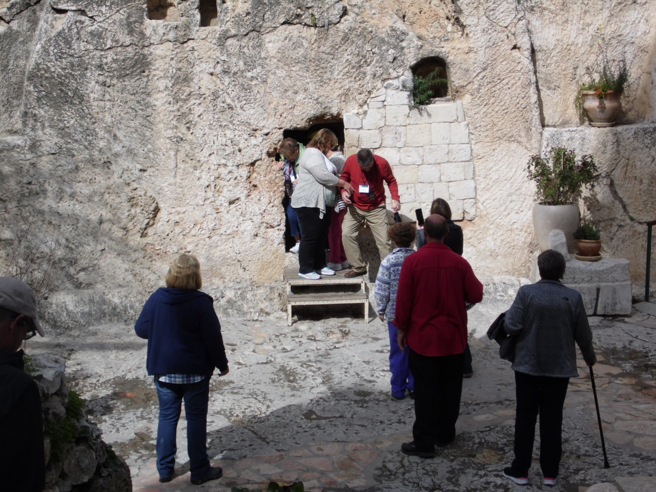
The Garden Tomb

Slide 23
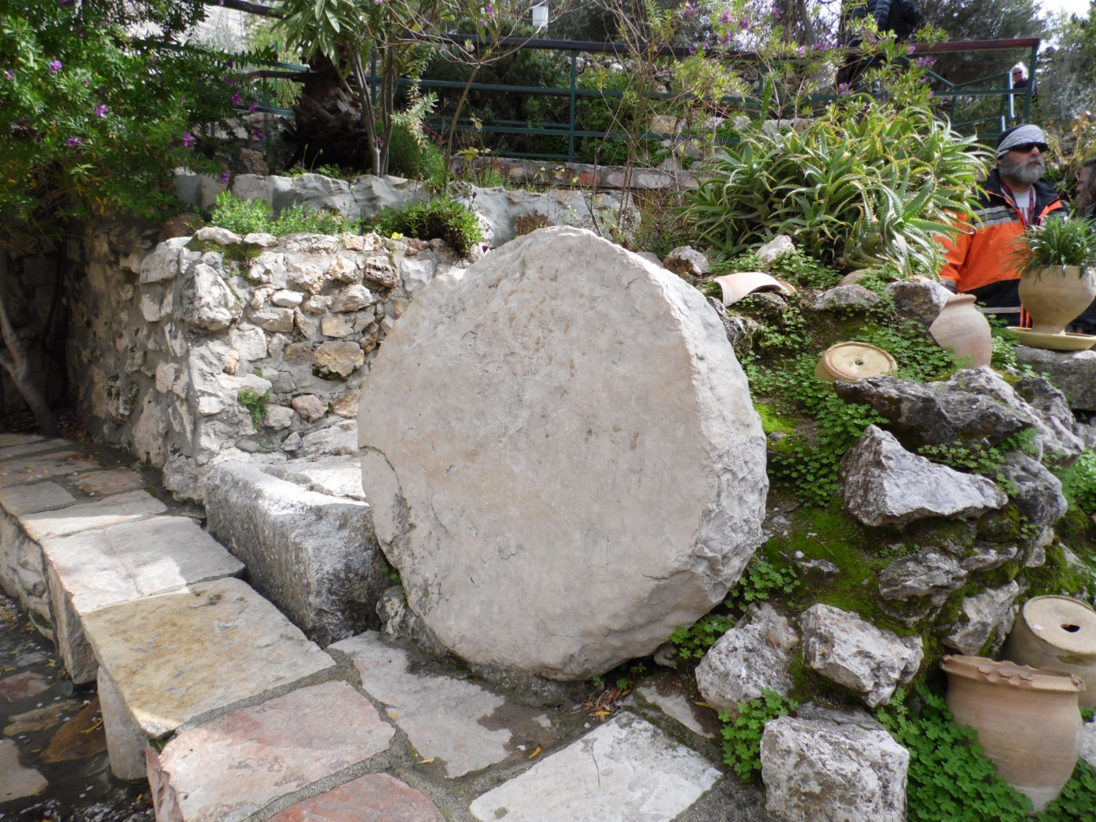
Stone to block Tomb Entrance

Slide 24
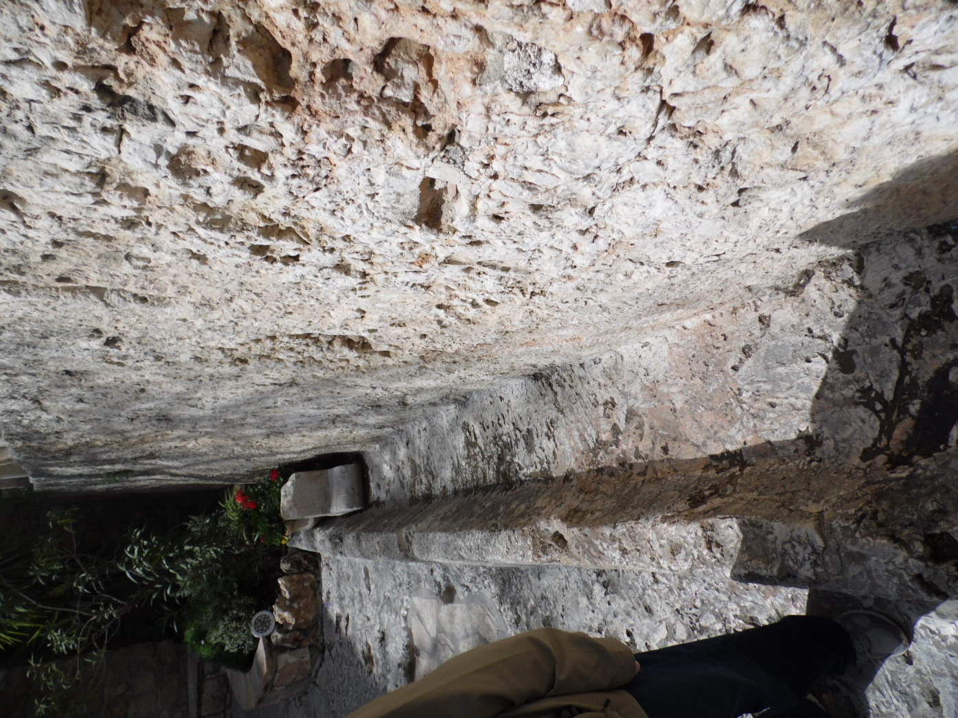
Track to keep Stone in place

Slide 25
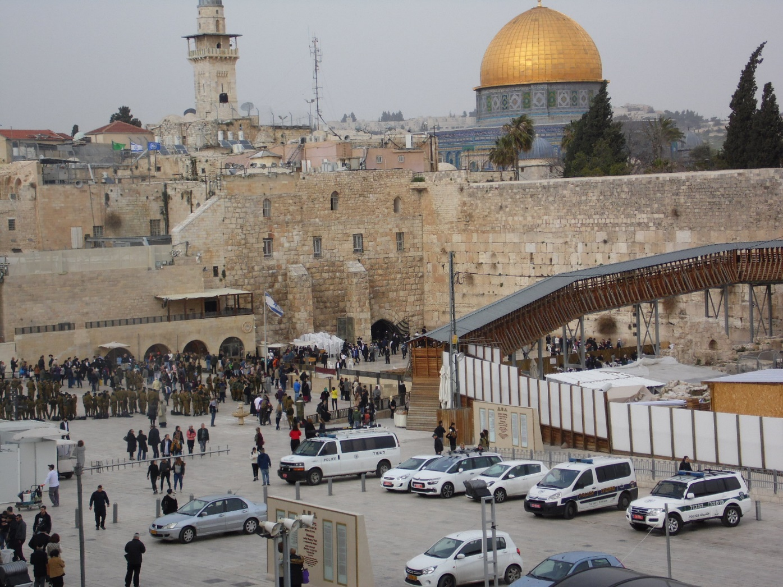
Western (Wailing) Wall

Slide 26
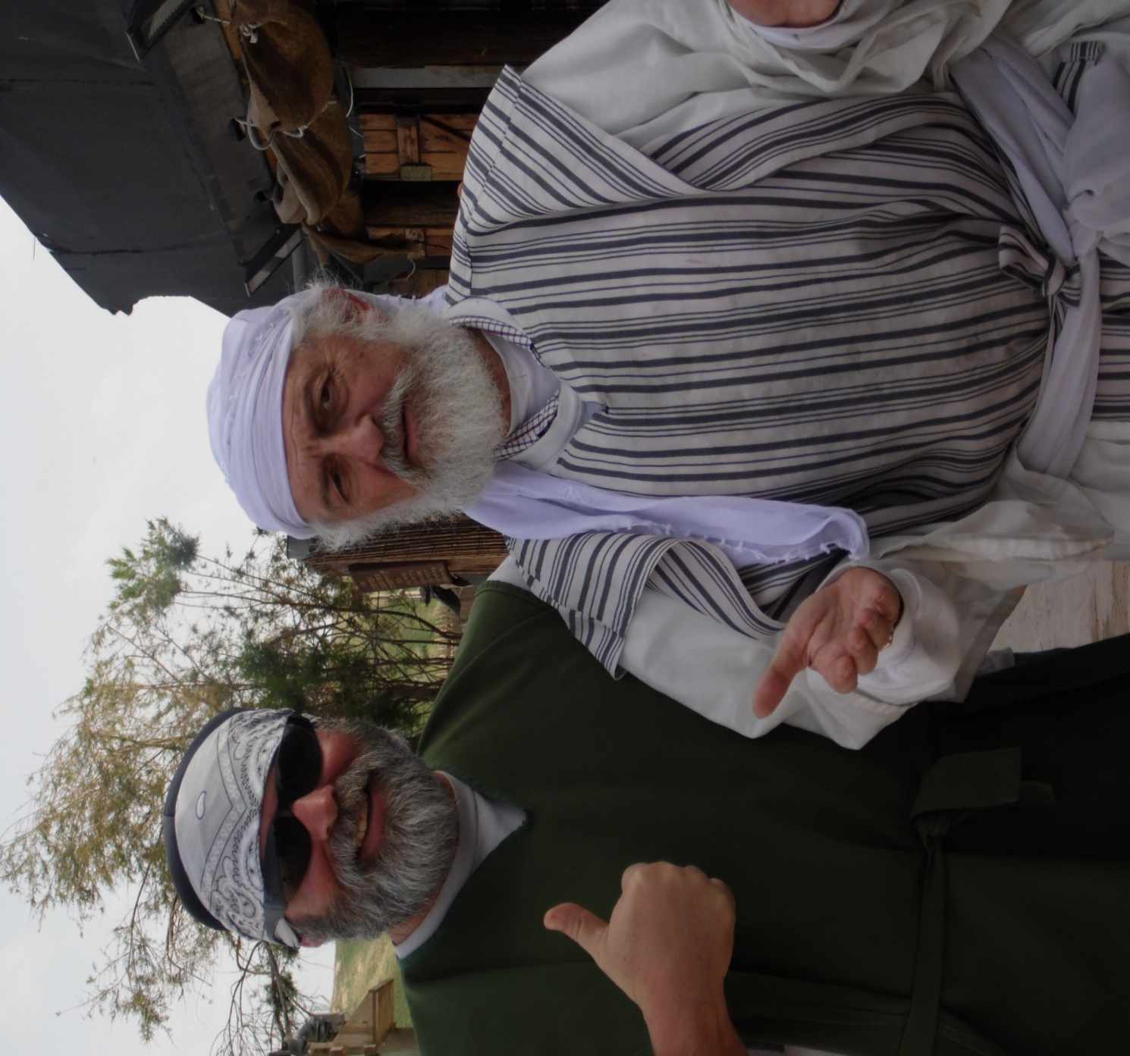
Me & Father Abraham

Slide 27
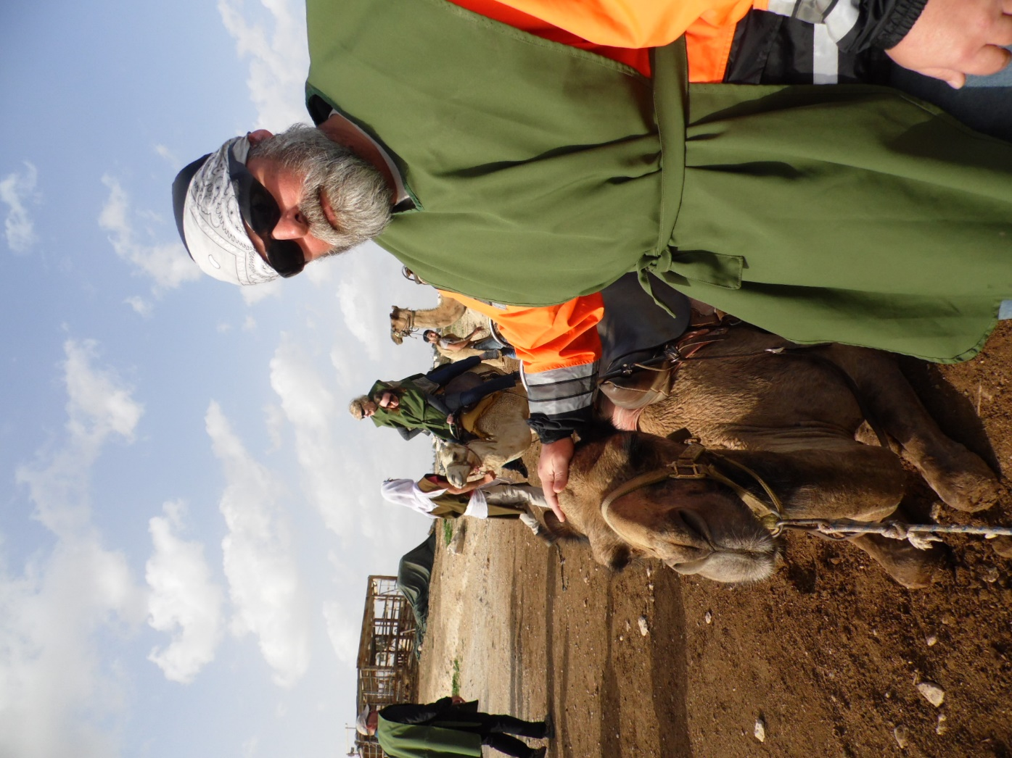
Me & Lumpy

