Slide 1
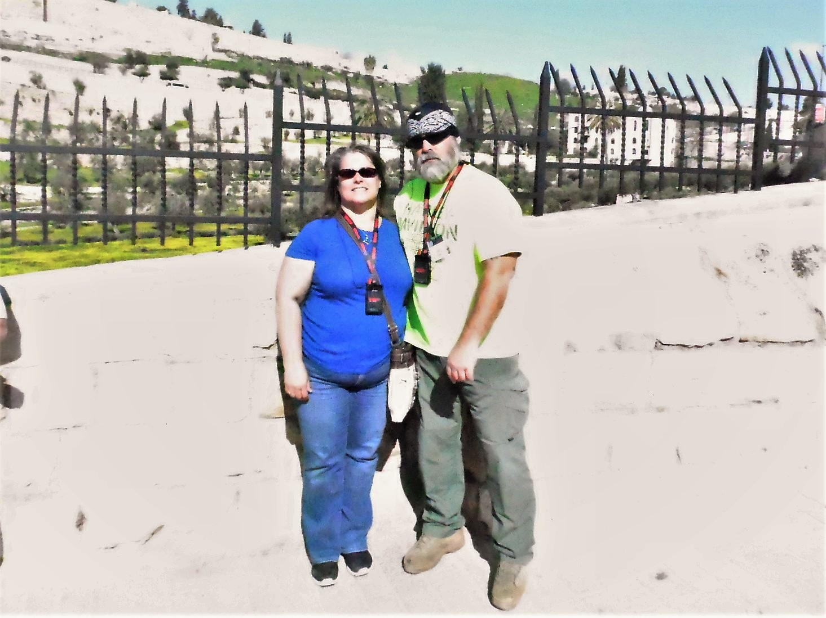
Exploring the Holy Land part III

Slide 2
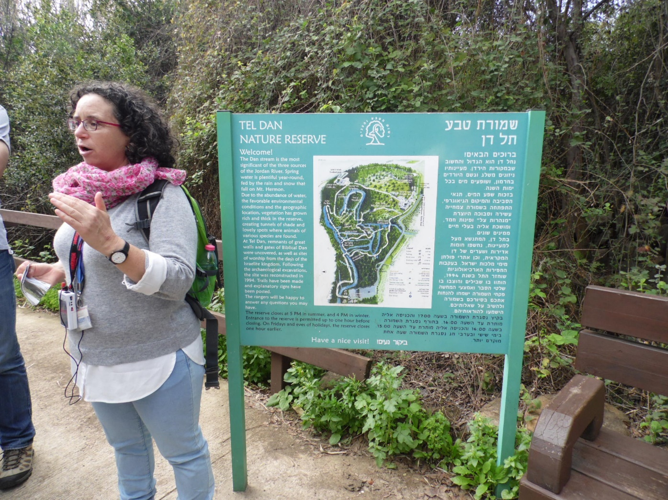
Tel Dan Nature Reserve

Slide 3
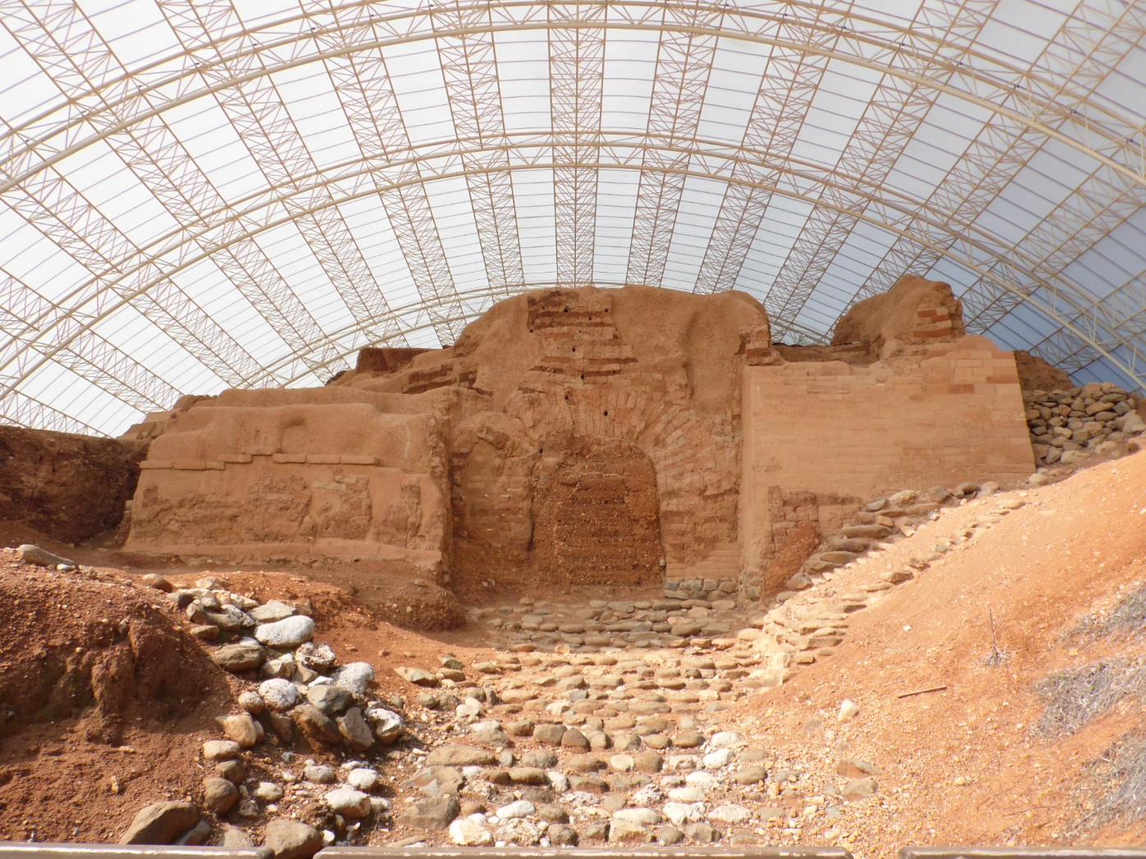
Abraham’s Gate

Slide 4
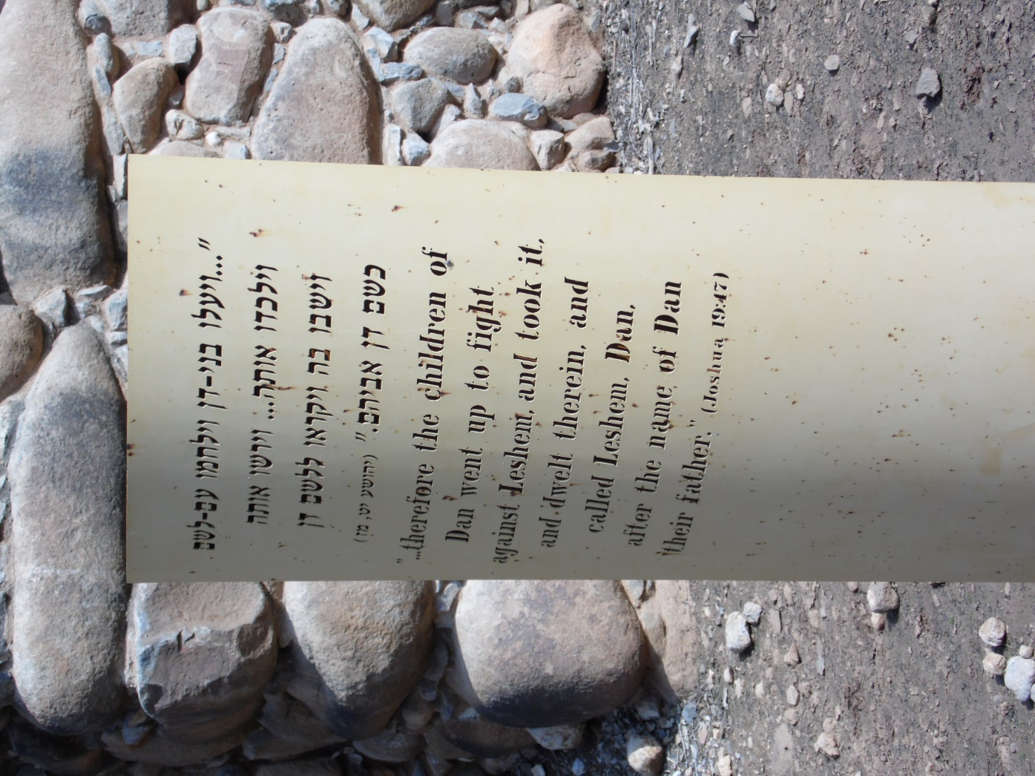
Joshua 19:47

Slide 5
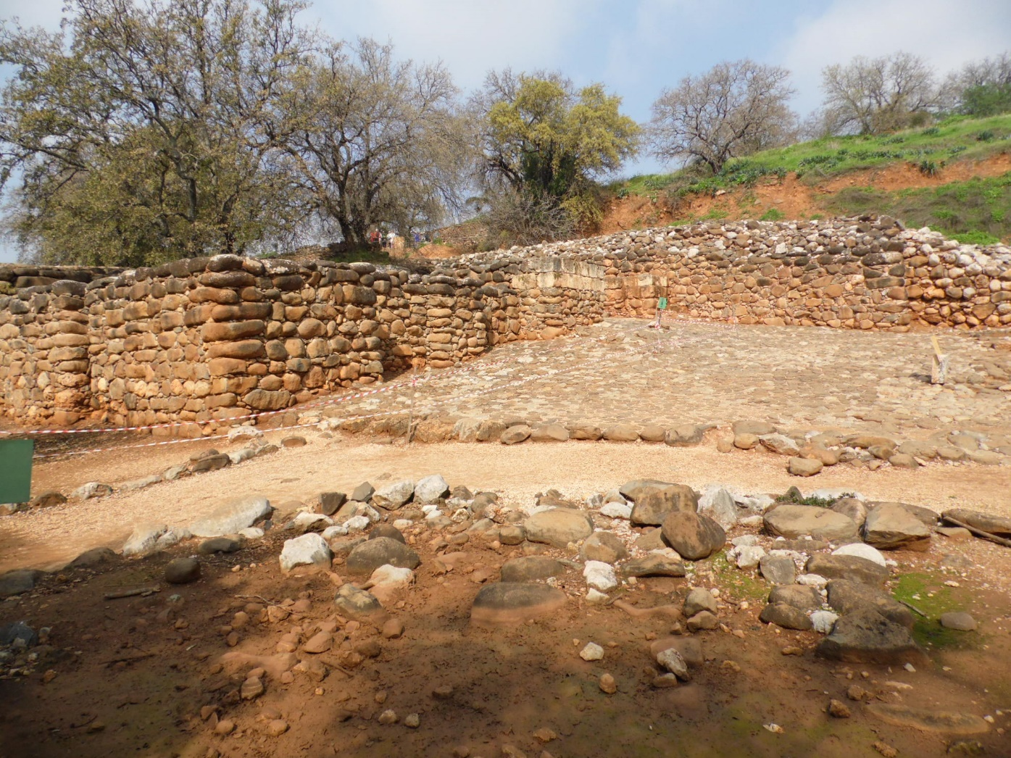
City Wall at Dan

Slide 6
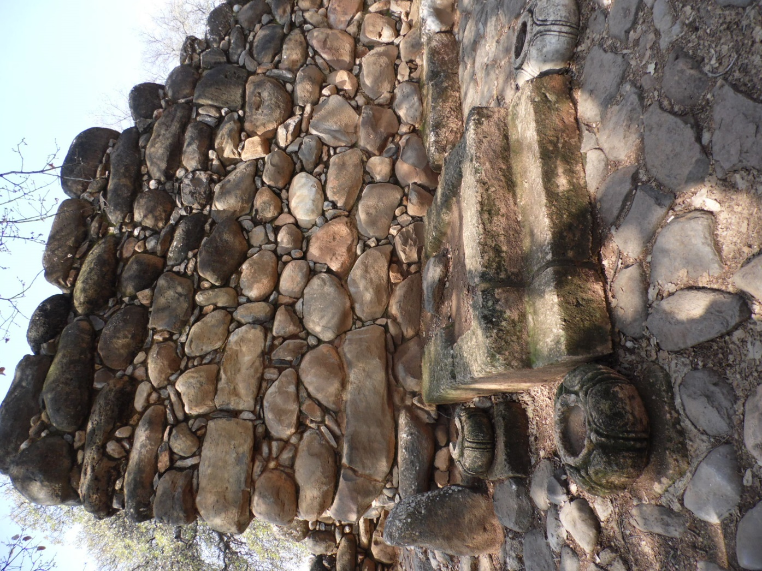
City Gate of Dan

Slide 7
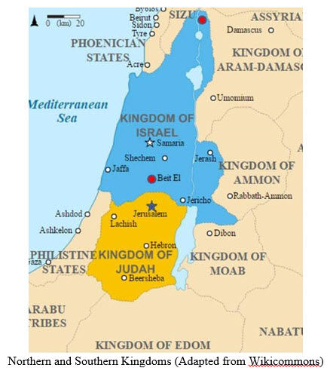
Dan & Bethel (red dots)

Slide 8
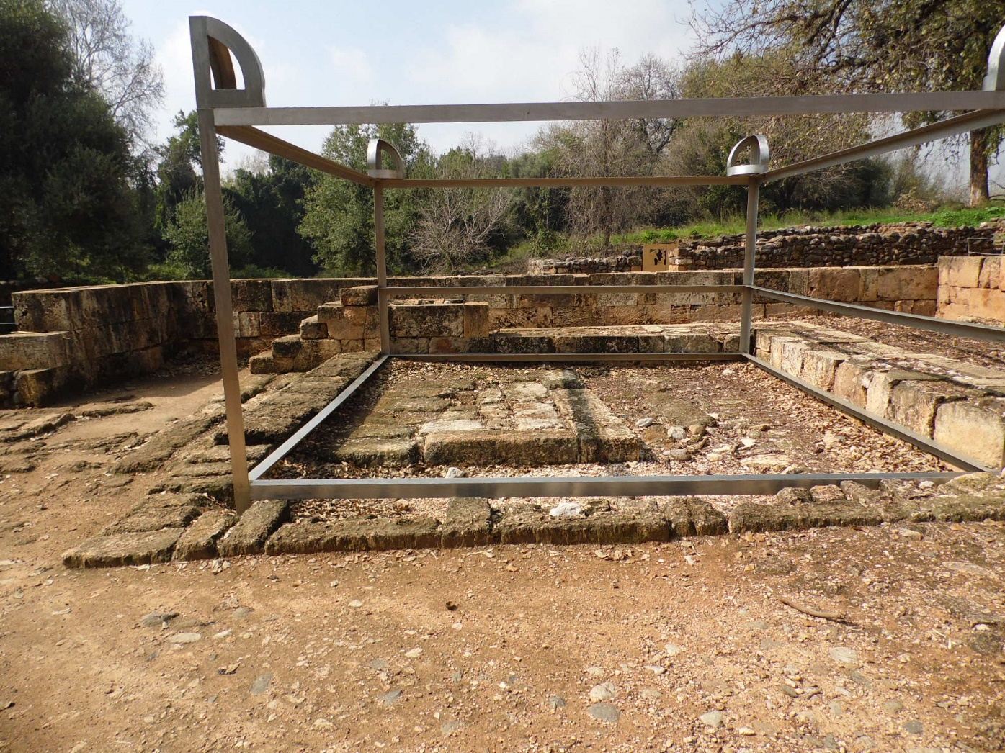
Altar of Golden Calf at Dan

Slide 9
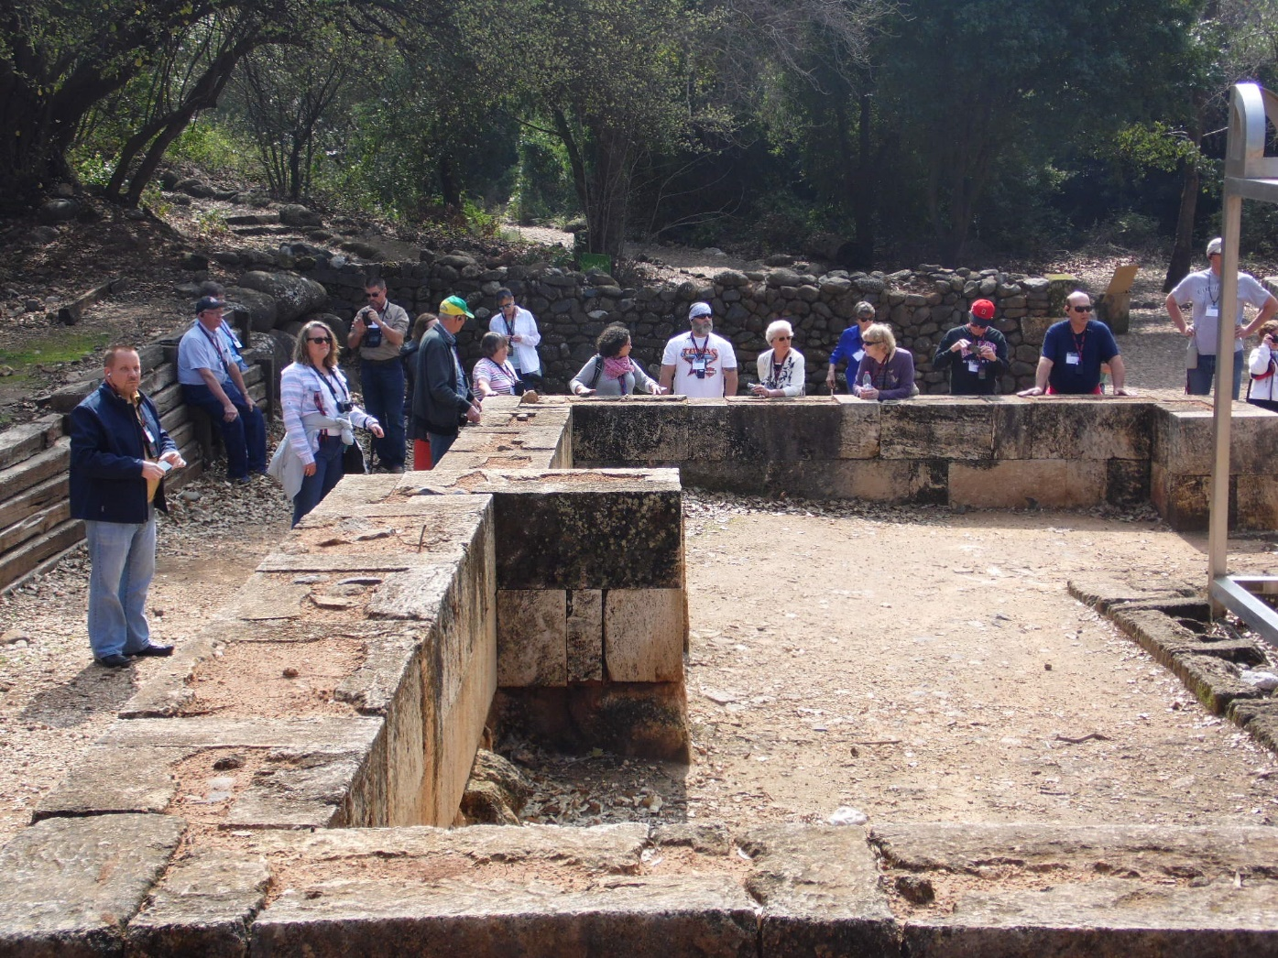
Wall around Golden Calf Idol

Slide 10
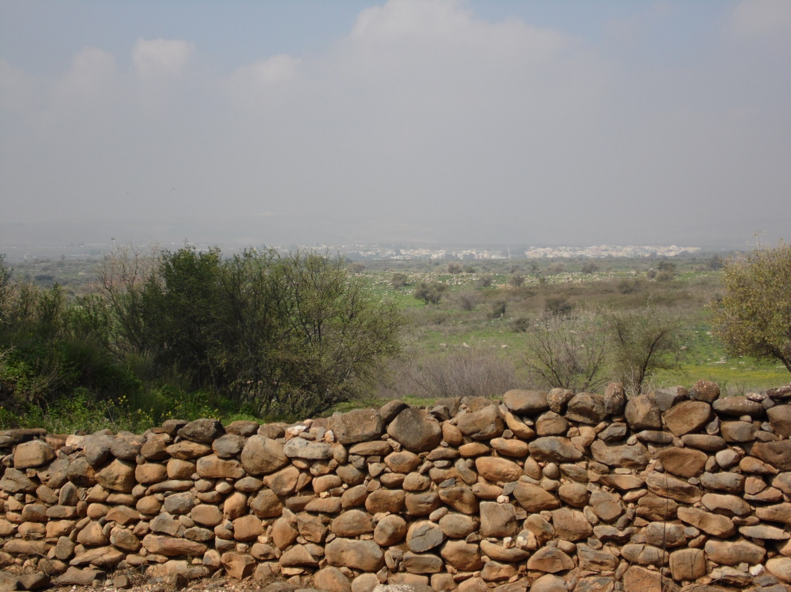
Looking into Lebanon

Slide 11
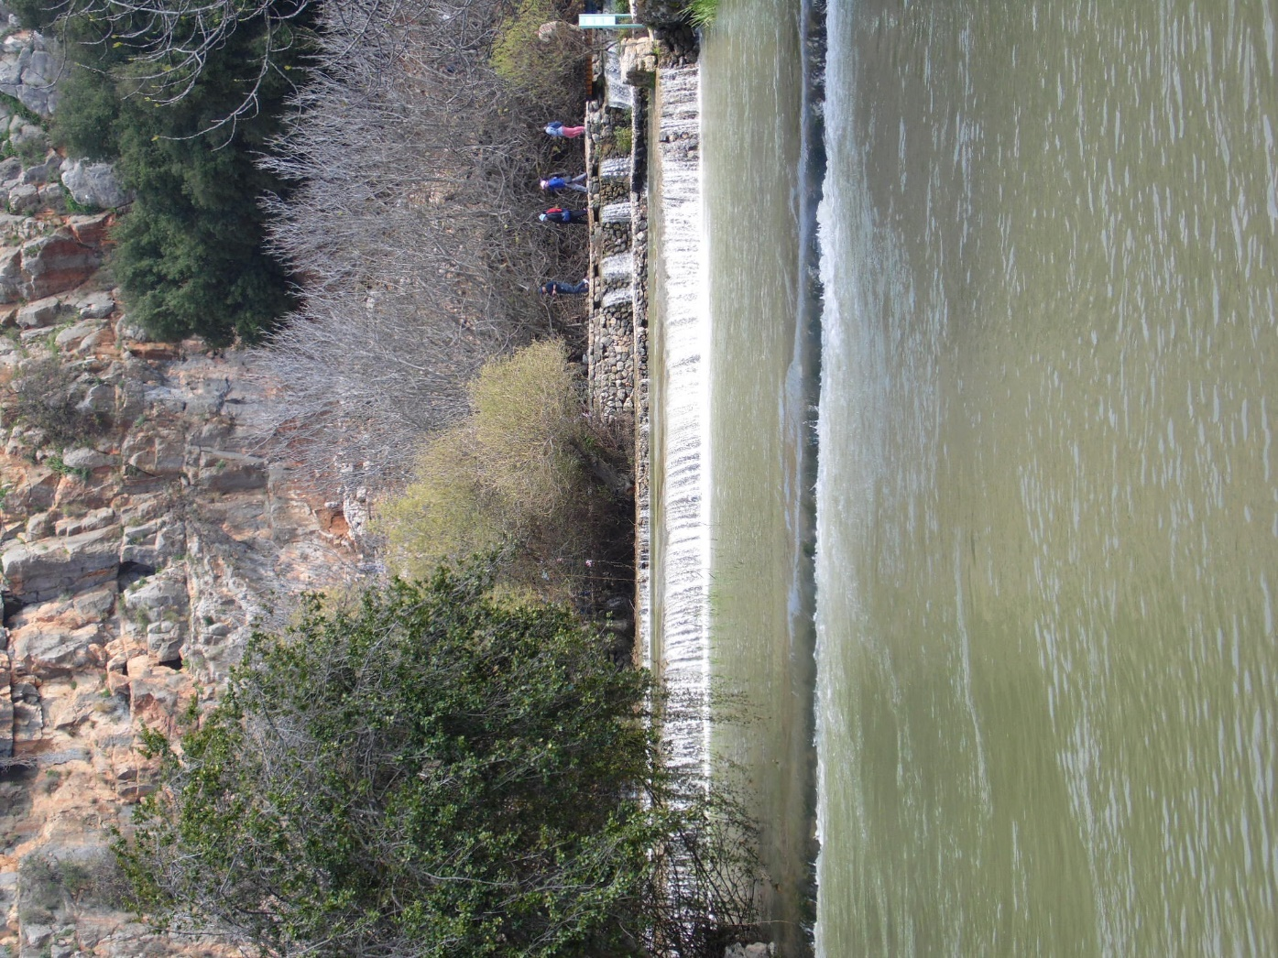
Caesarea Philippi

Slide 12
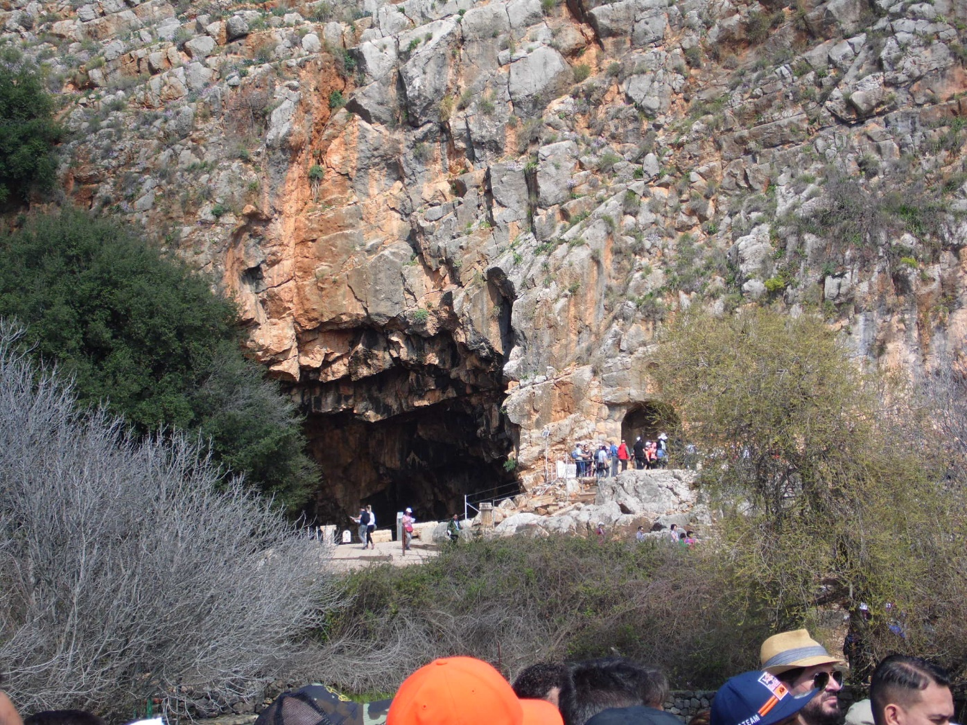
Caves at Caesarea Philippi

Slide 13
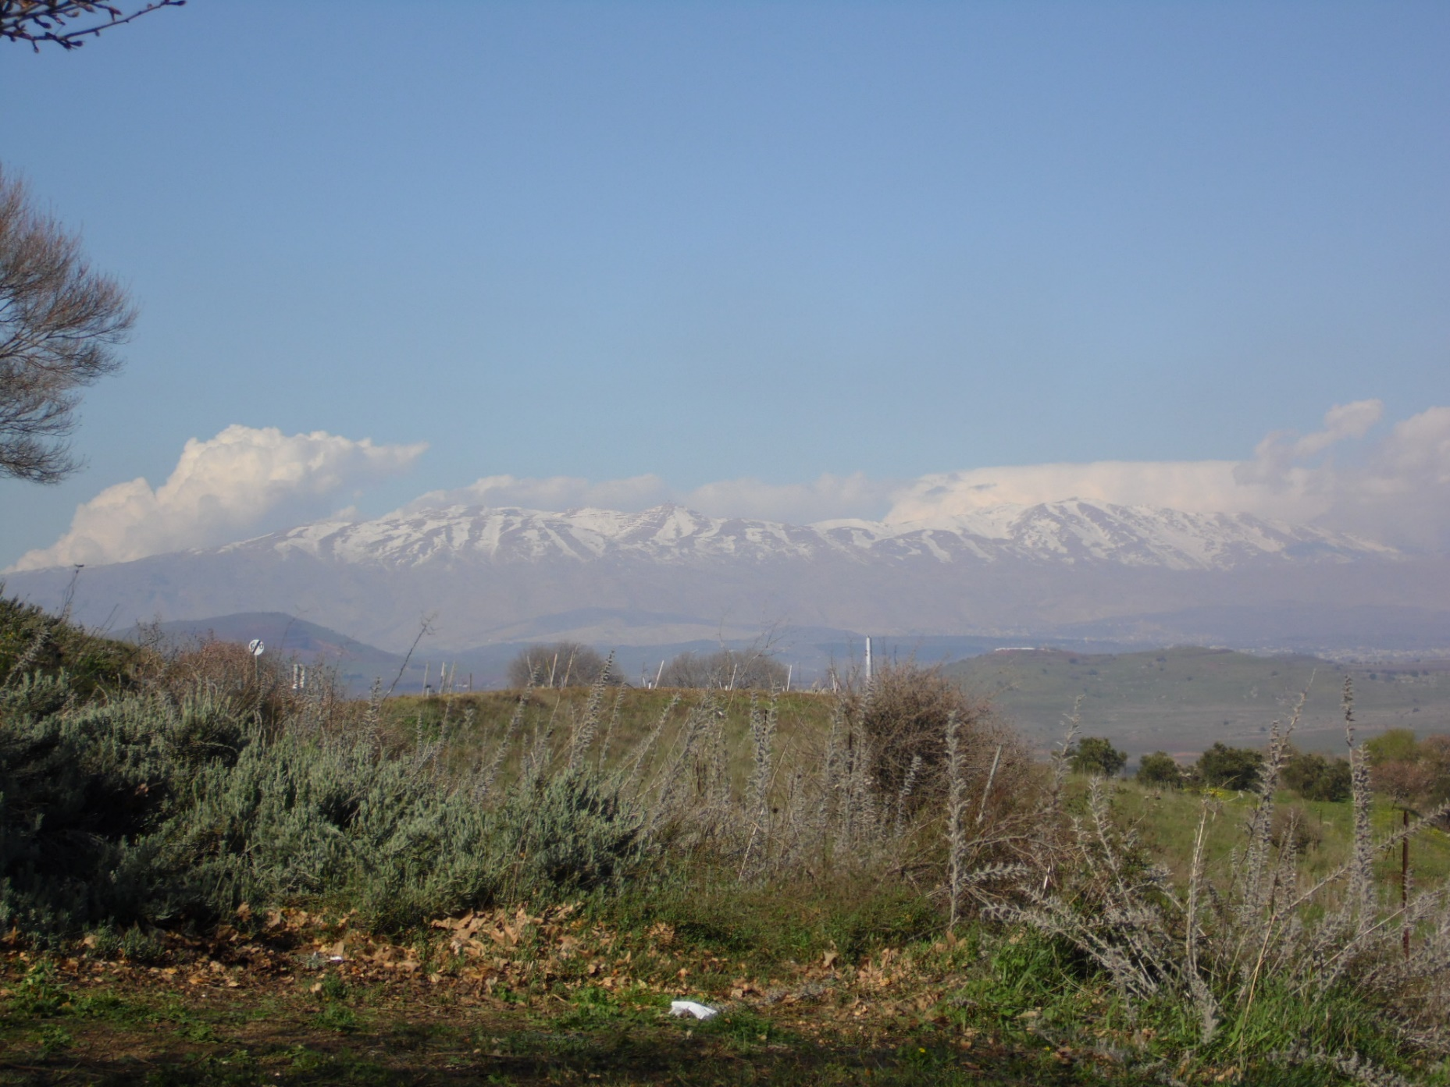
Mt. Hermon (Mt. of Transfiguration)

Slide 14
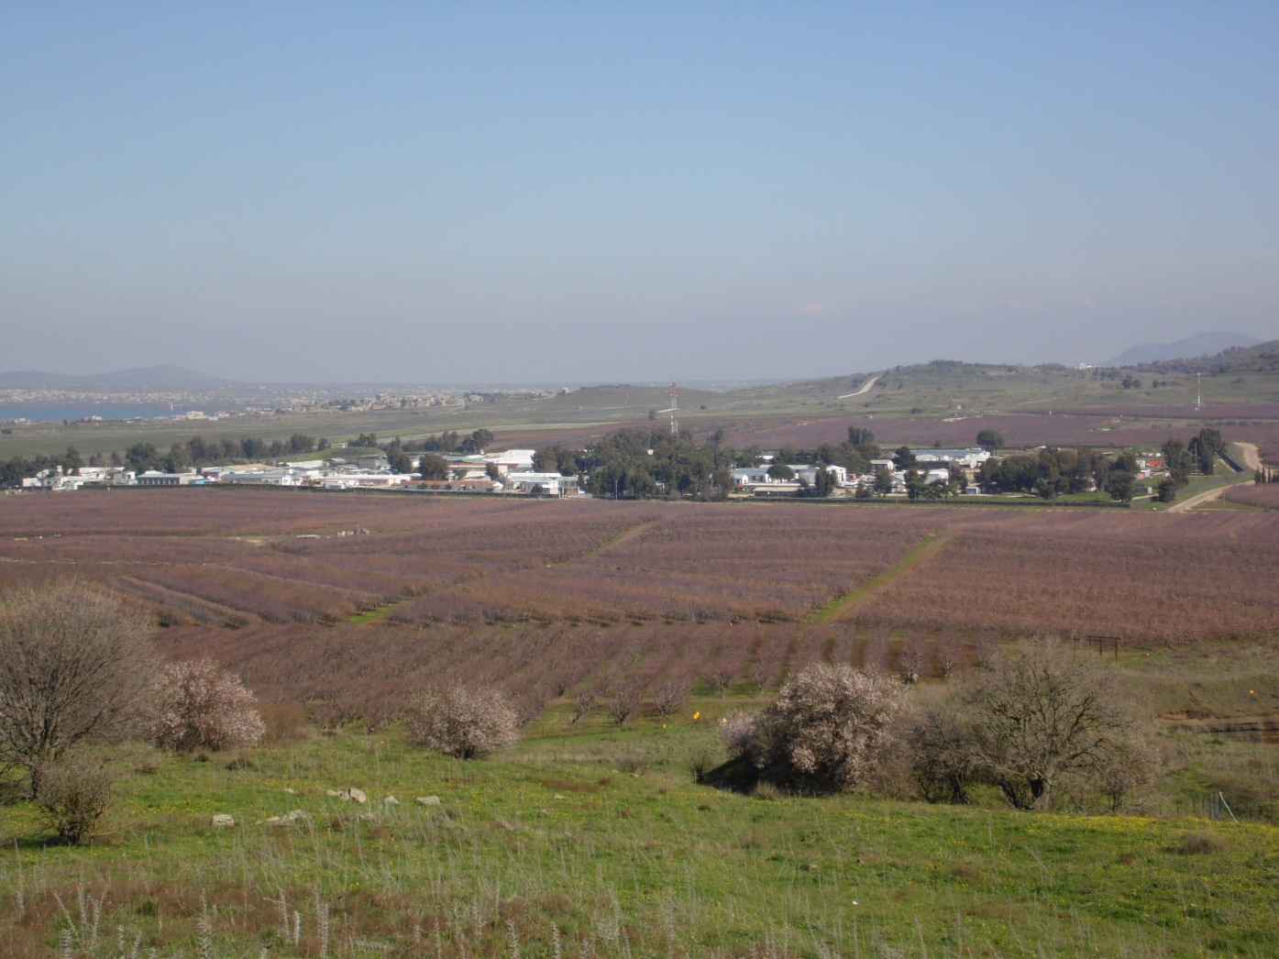
U.N. Compound – Golan Heights

Slide 15
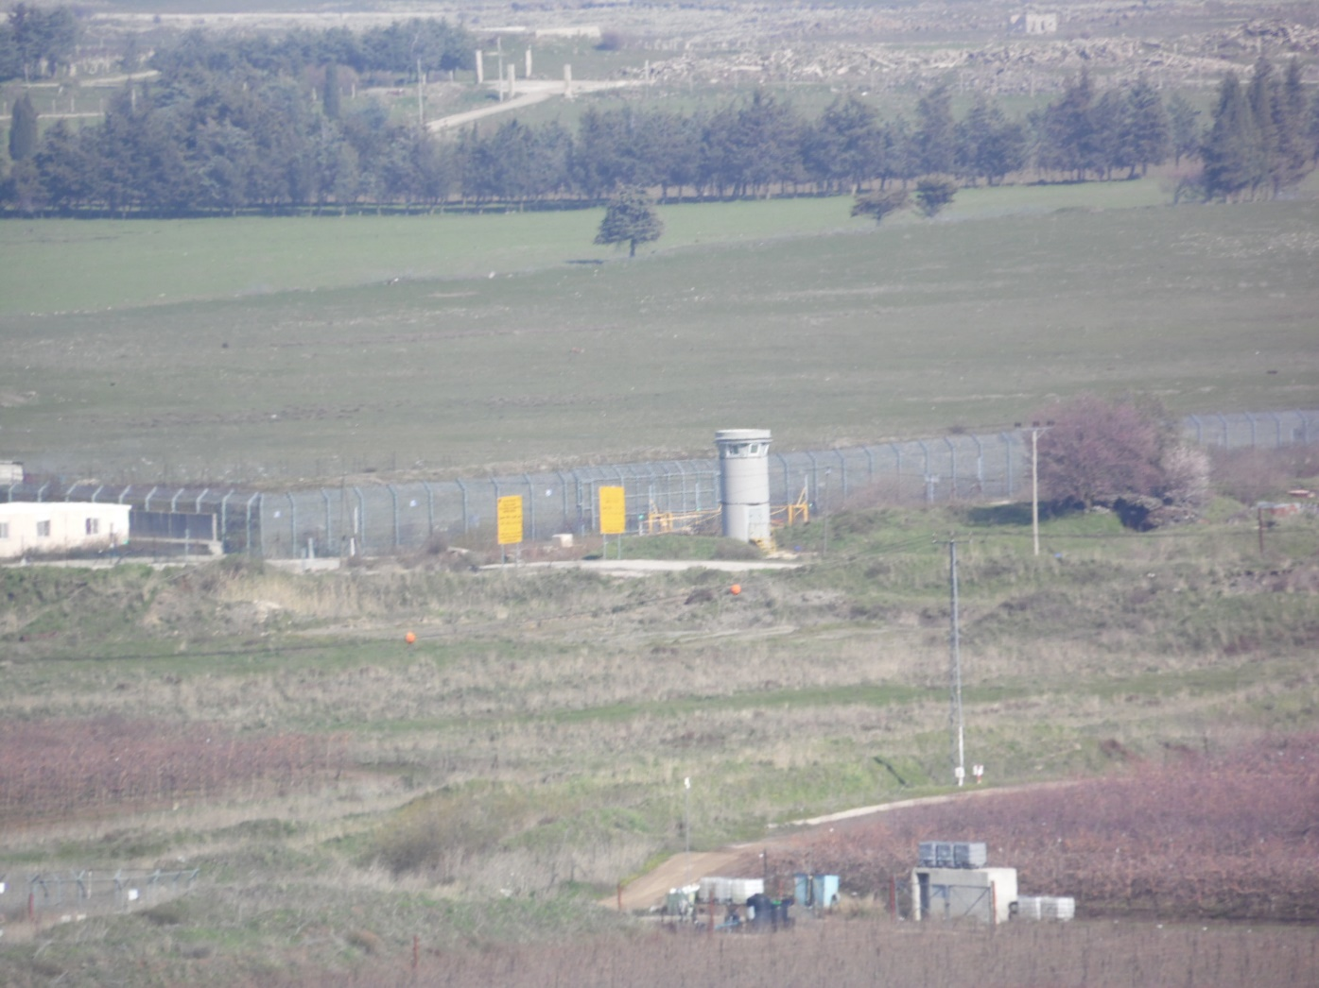
Israel/Syria Border Fence

Slide 16
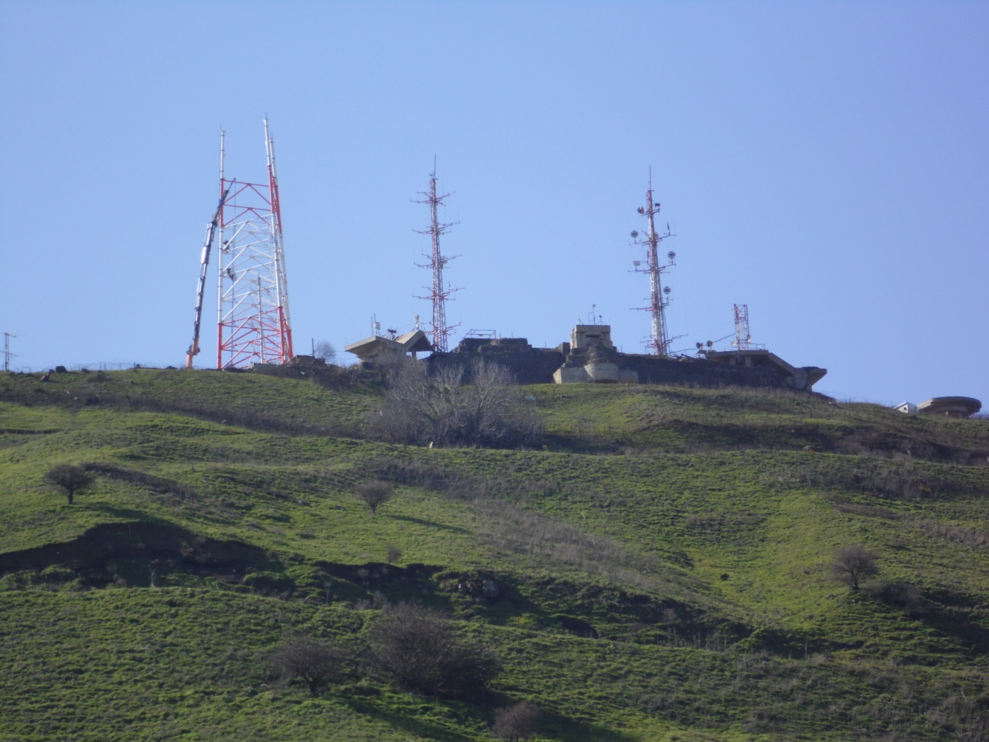
I.D.F. Base overlooking Syria

Slide 17
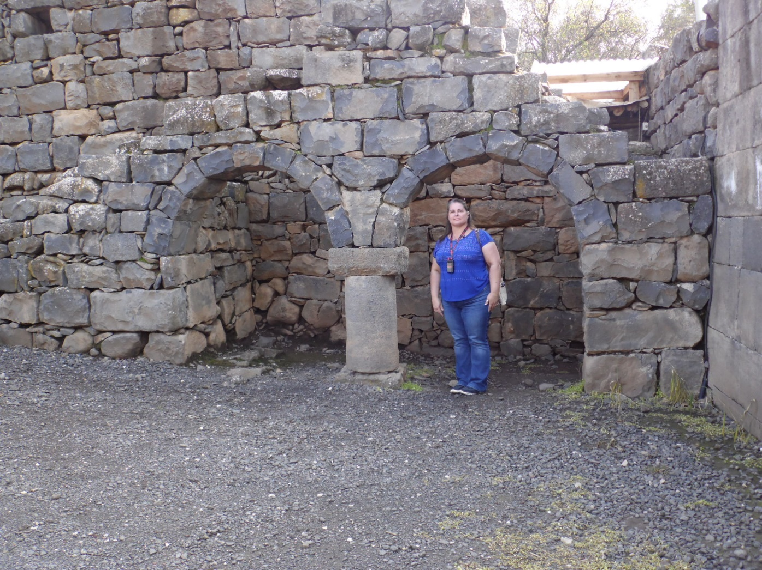
Village of Katzrin

Slide 18
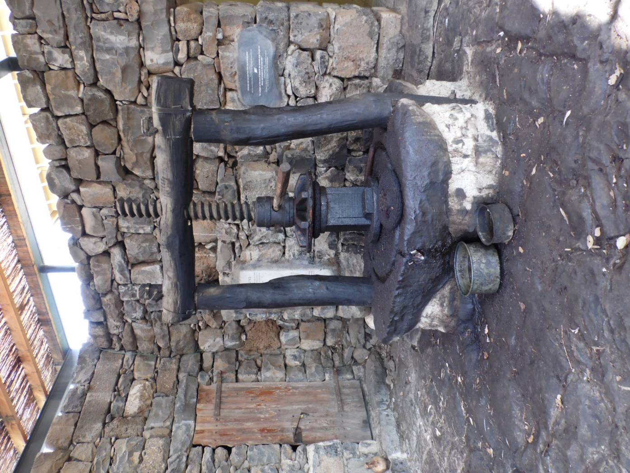
Ancient Olive Press in Katzrin

Slide 19
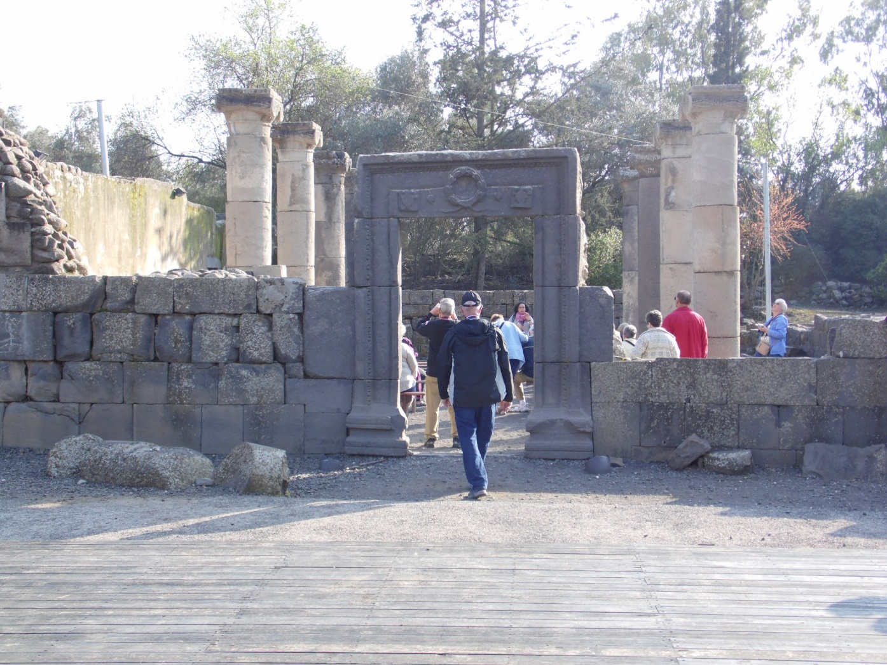
5th Century Synagogue in Katzrin

Slide 20
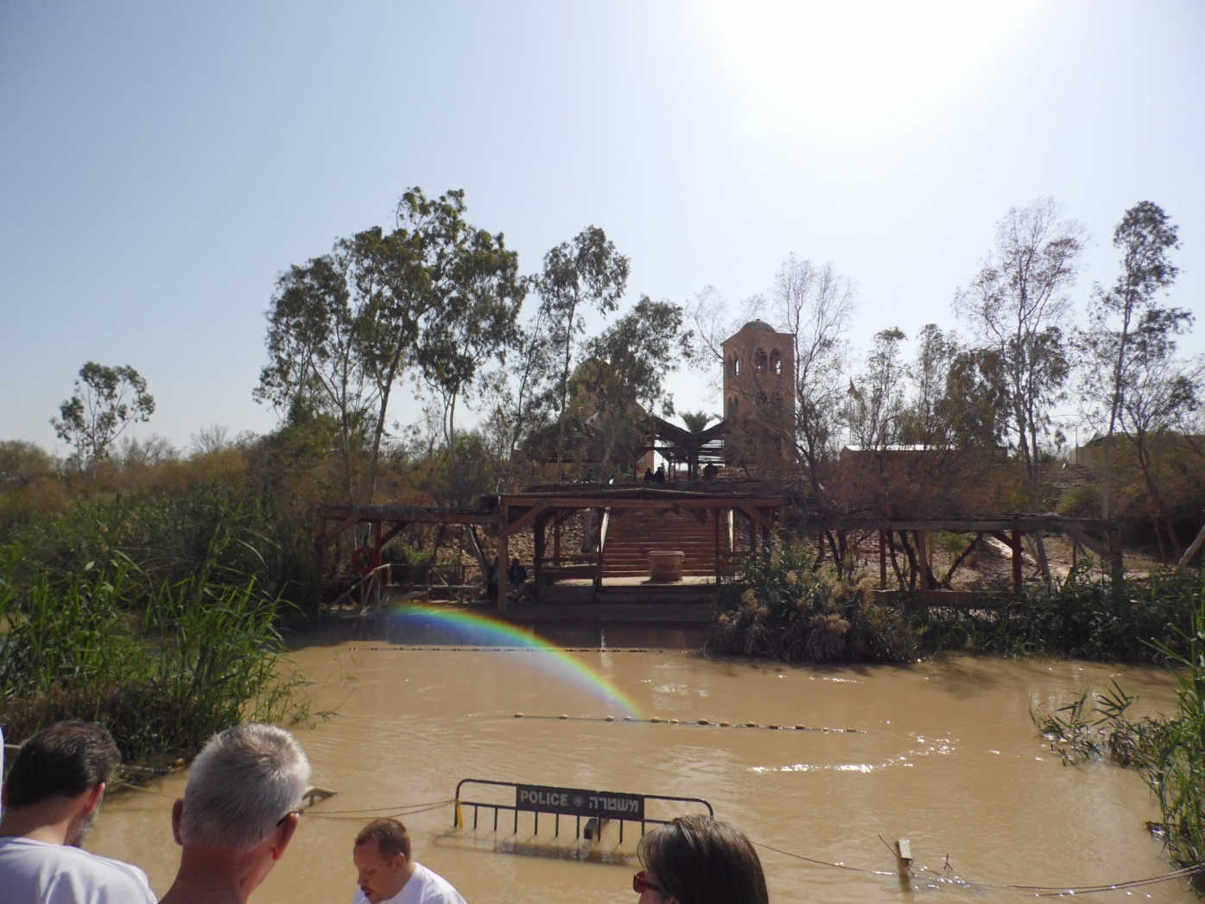
Jordon River

Slide 21
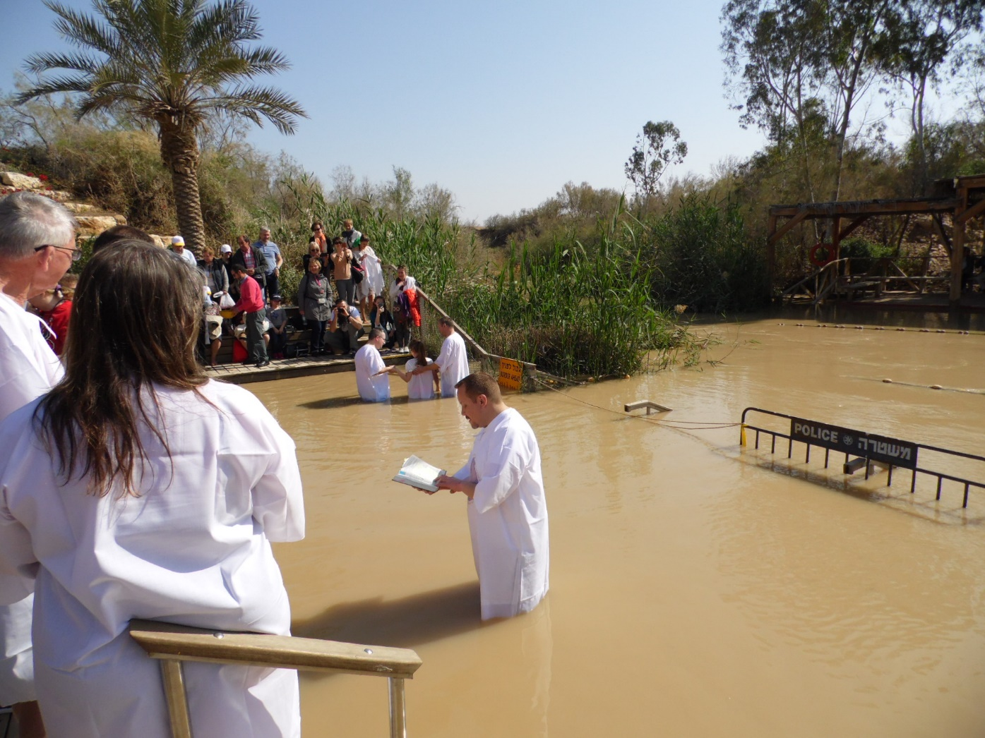
Baptism Service at Jordon River

Slide 22
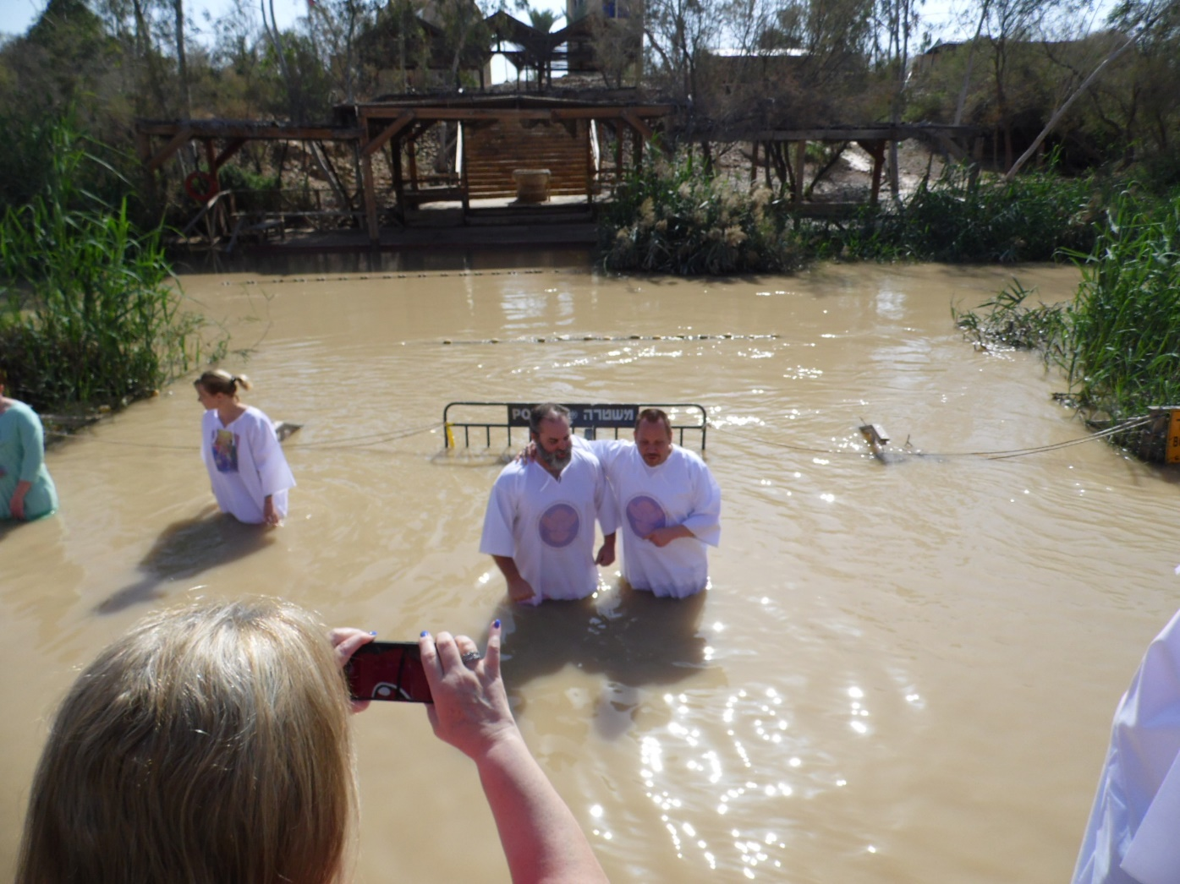
Getting Baptized in the Jordon River

Slide 23
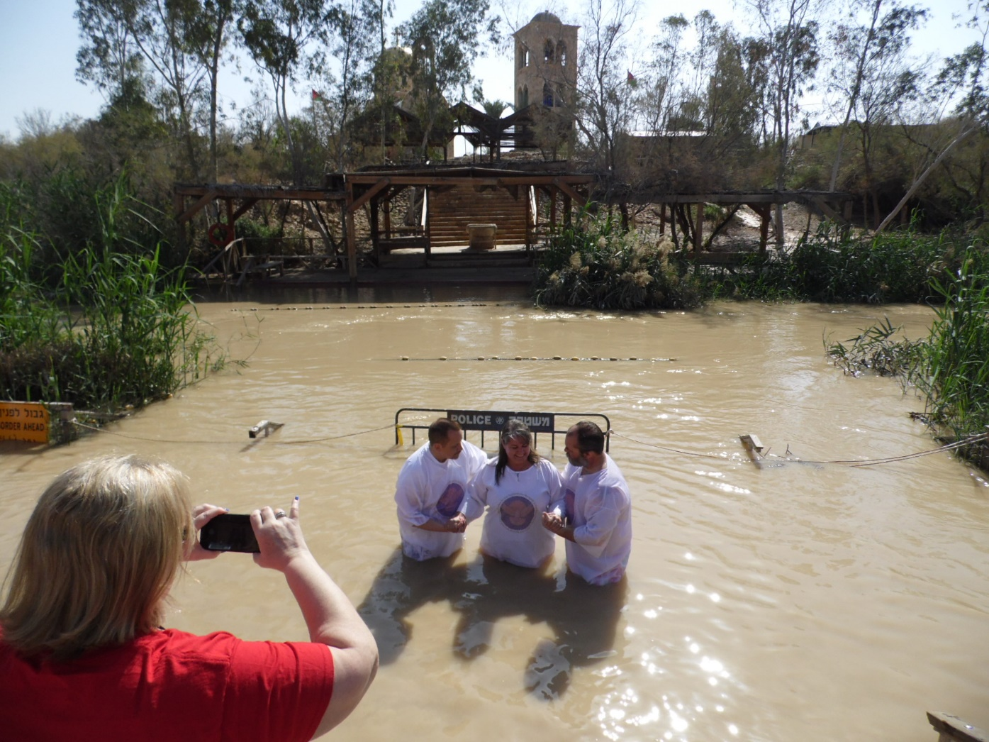
Baptizing Shiela in Jordon River

Slide 24
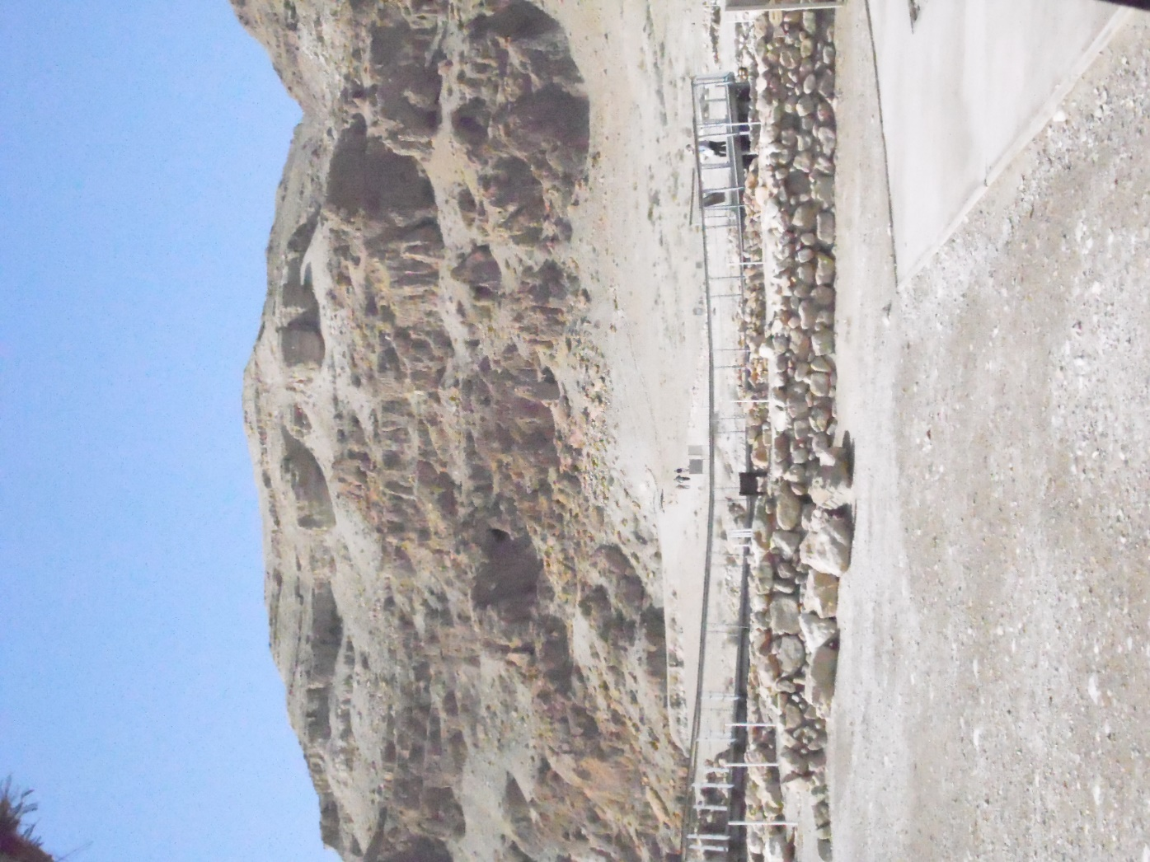
Qumran

Slide 25
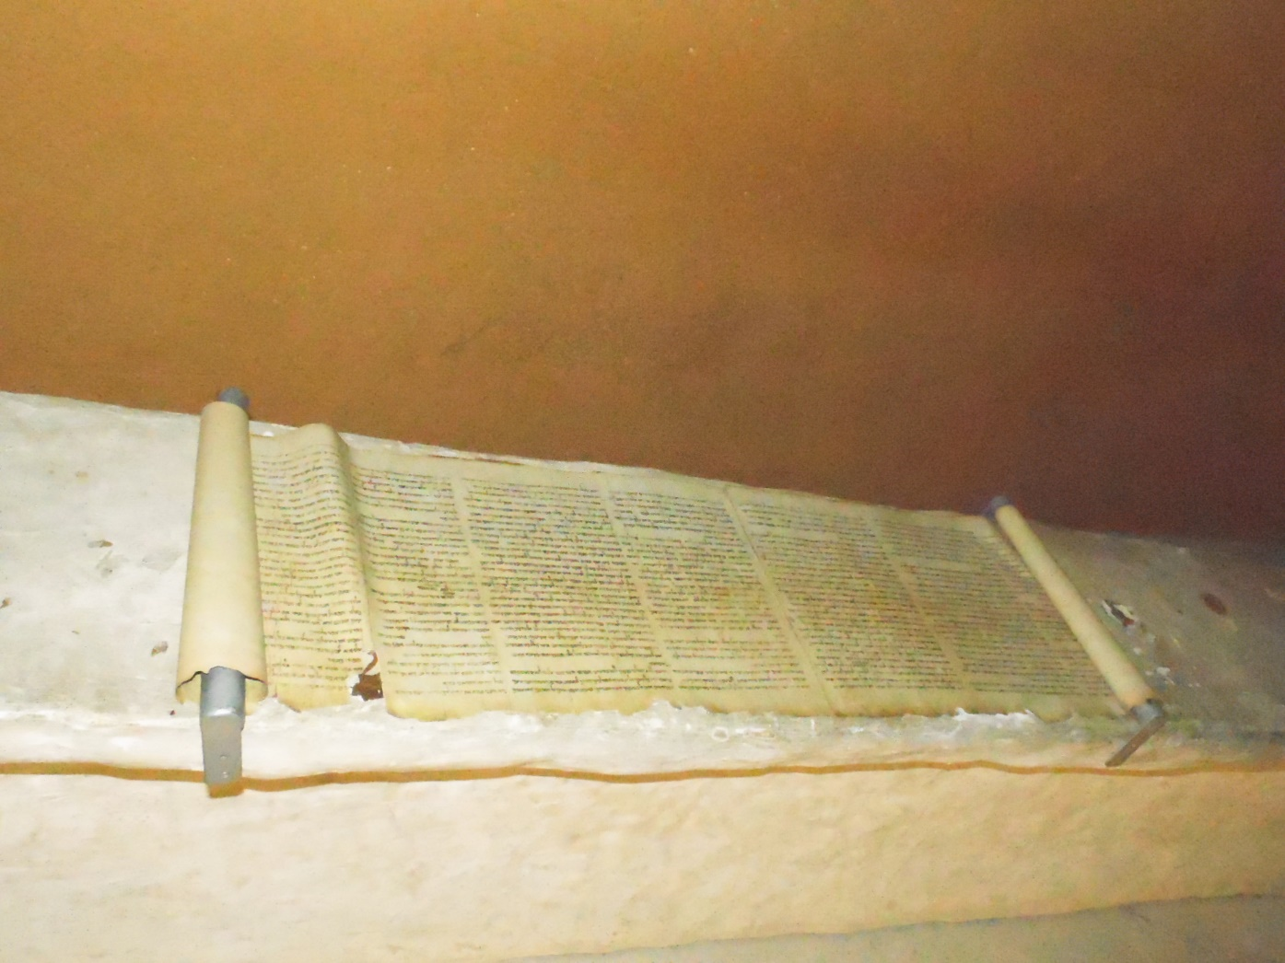
Isaiah Scroll

Slide 26
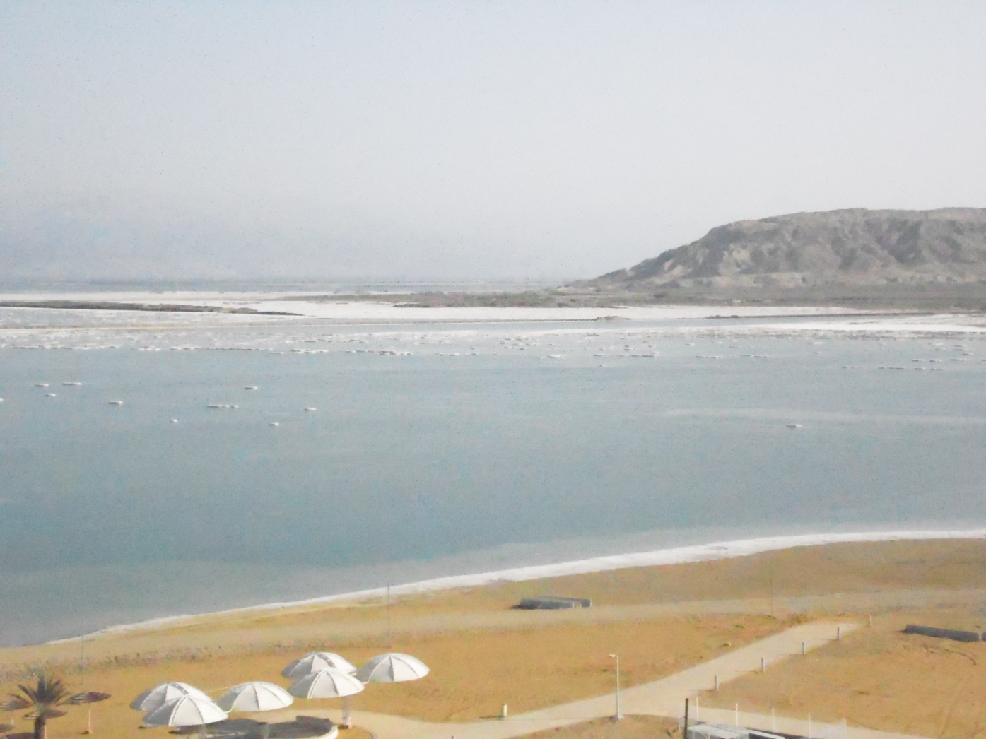
View of Dead Sea

Slide 27
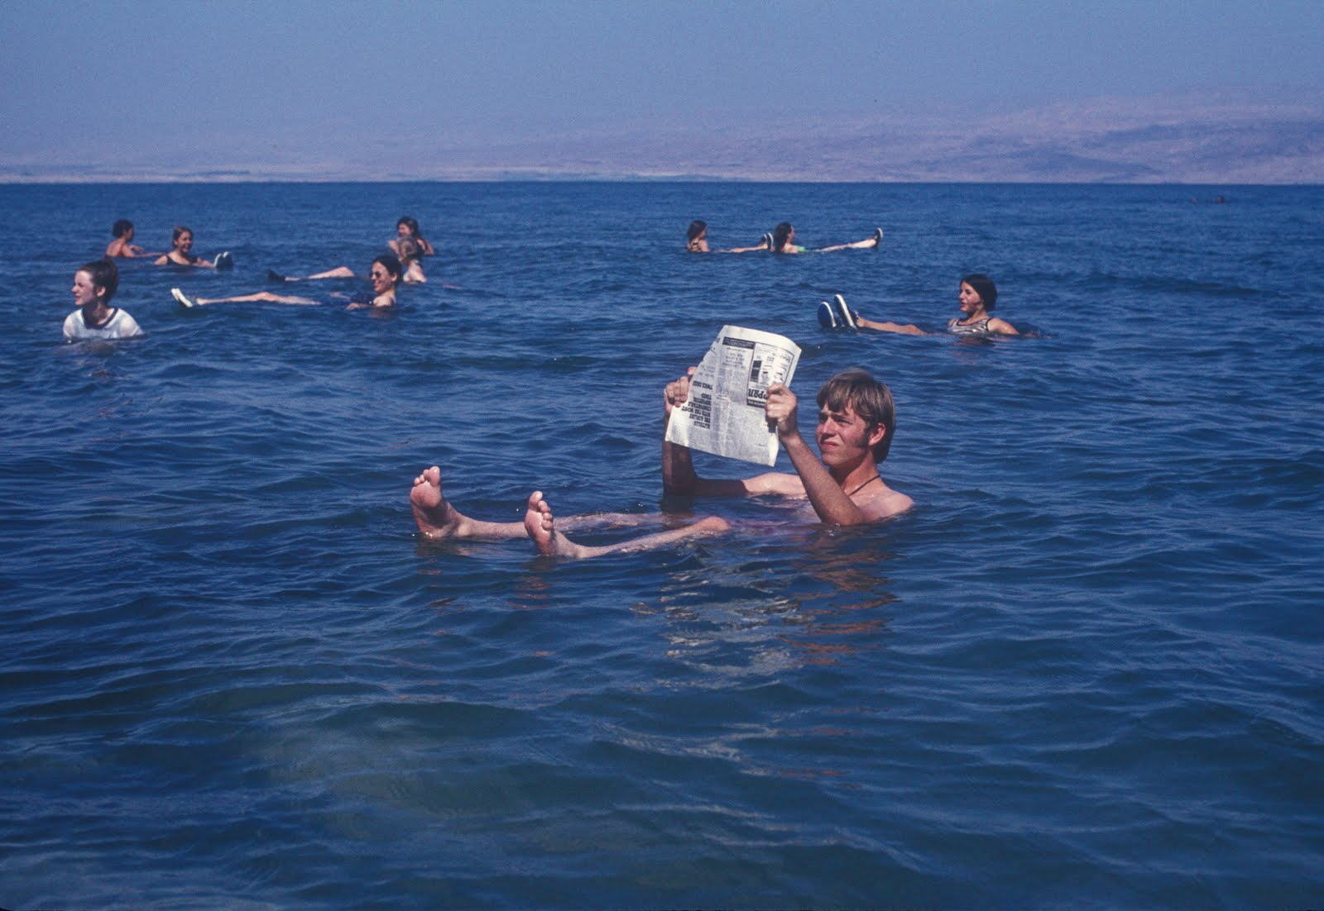
Floating in Dead Sea

Slide 28
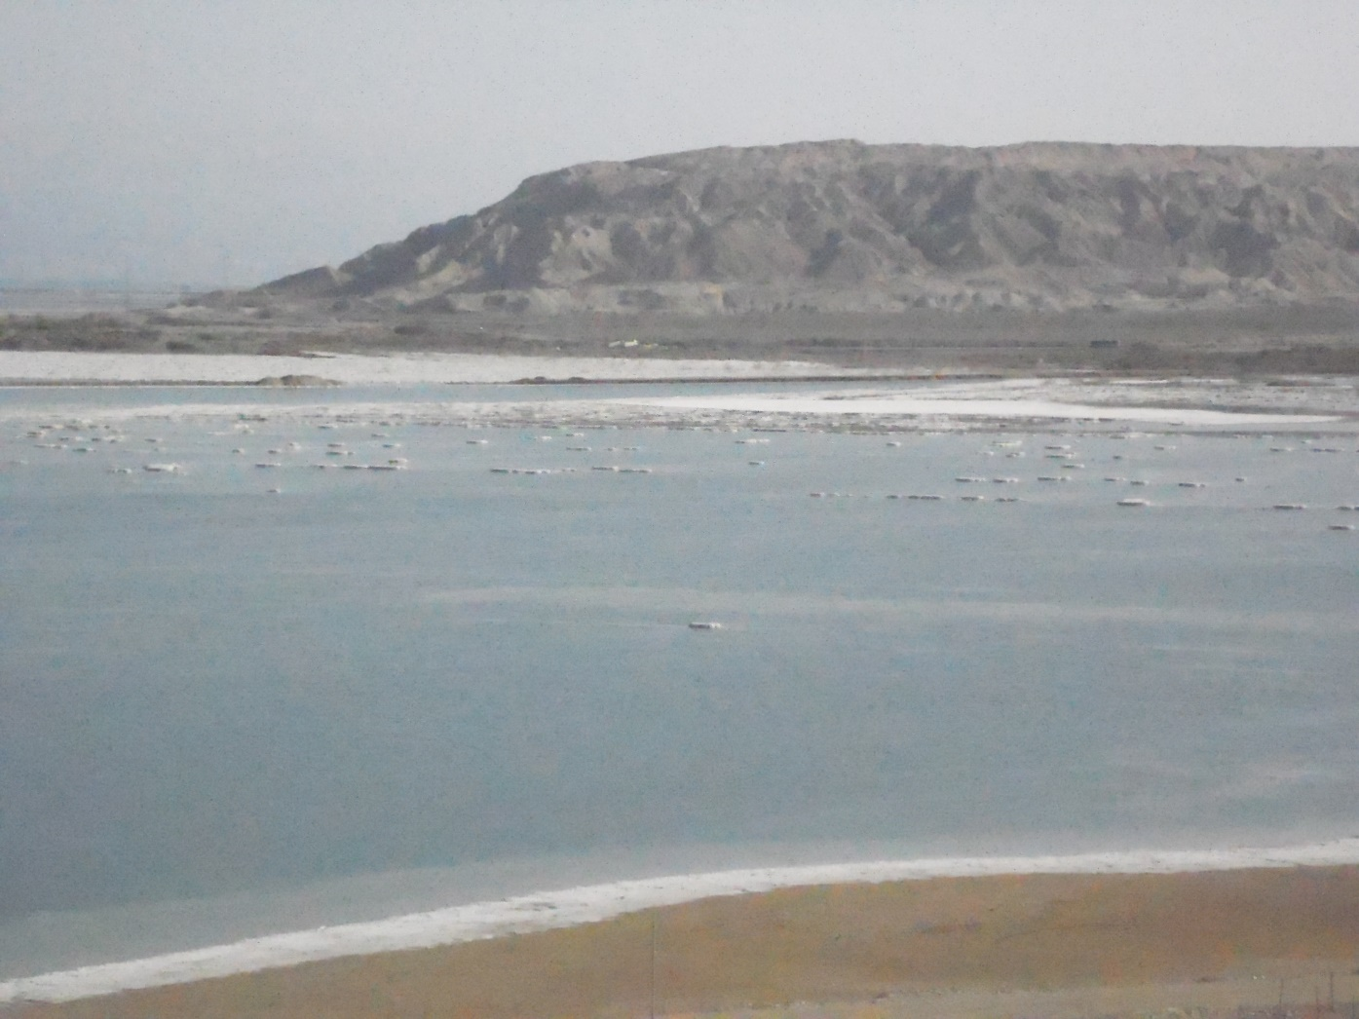
Sundown on the Dead Sea

