Slide 1
A Wedding, Two Feasts, and a Fight
Revelation 19

Slide 2
Rejoicing in Heaven
The Great Tribulation is over
God will avenge the blood of His Saints
The Tribulation Saints, The Church, and The Angels rejoice together

Slide 3
The Wedding of the Lamb
The Church is the “Bride of Christ”
Marriage is a picture of Christ and His Church
The Bride will wear fine linen – bright and clean

Slide 4
Wedding Supper of the Lamb
Begins after Jesus returns to earth
O.T. Saints and Tribulation survivors will be on the guest list
This celebration will last 1,000 years

Slide 5
The Second Coming of Christ
He is coming to execute judgment
We will come back with Him
Jesus will destroy His enemies with the “Sword of His Mouth”

Slide 6
The Great Supper of God
They will not “eat” the food – they will “be” the food
The Anti-Christ and the False Prophet are cast into the Lake of Fire
Birds eat the flesh of the Anti-Christ’s Army

Slide 7
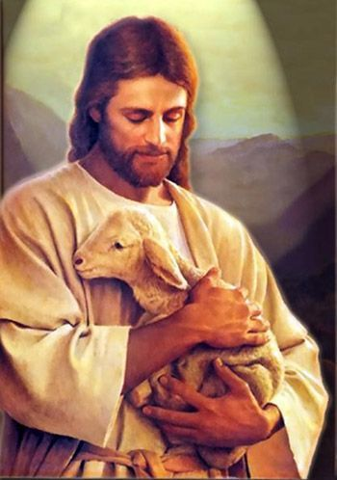
Receive Him as Savior Today

