Slide 1
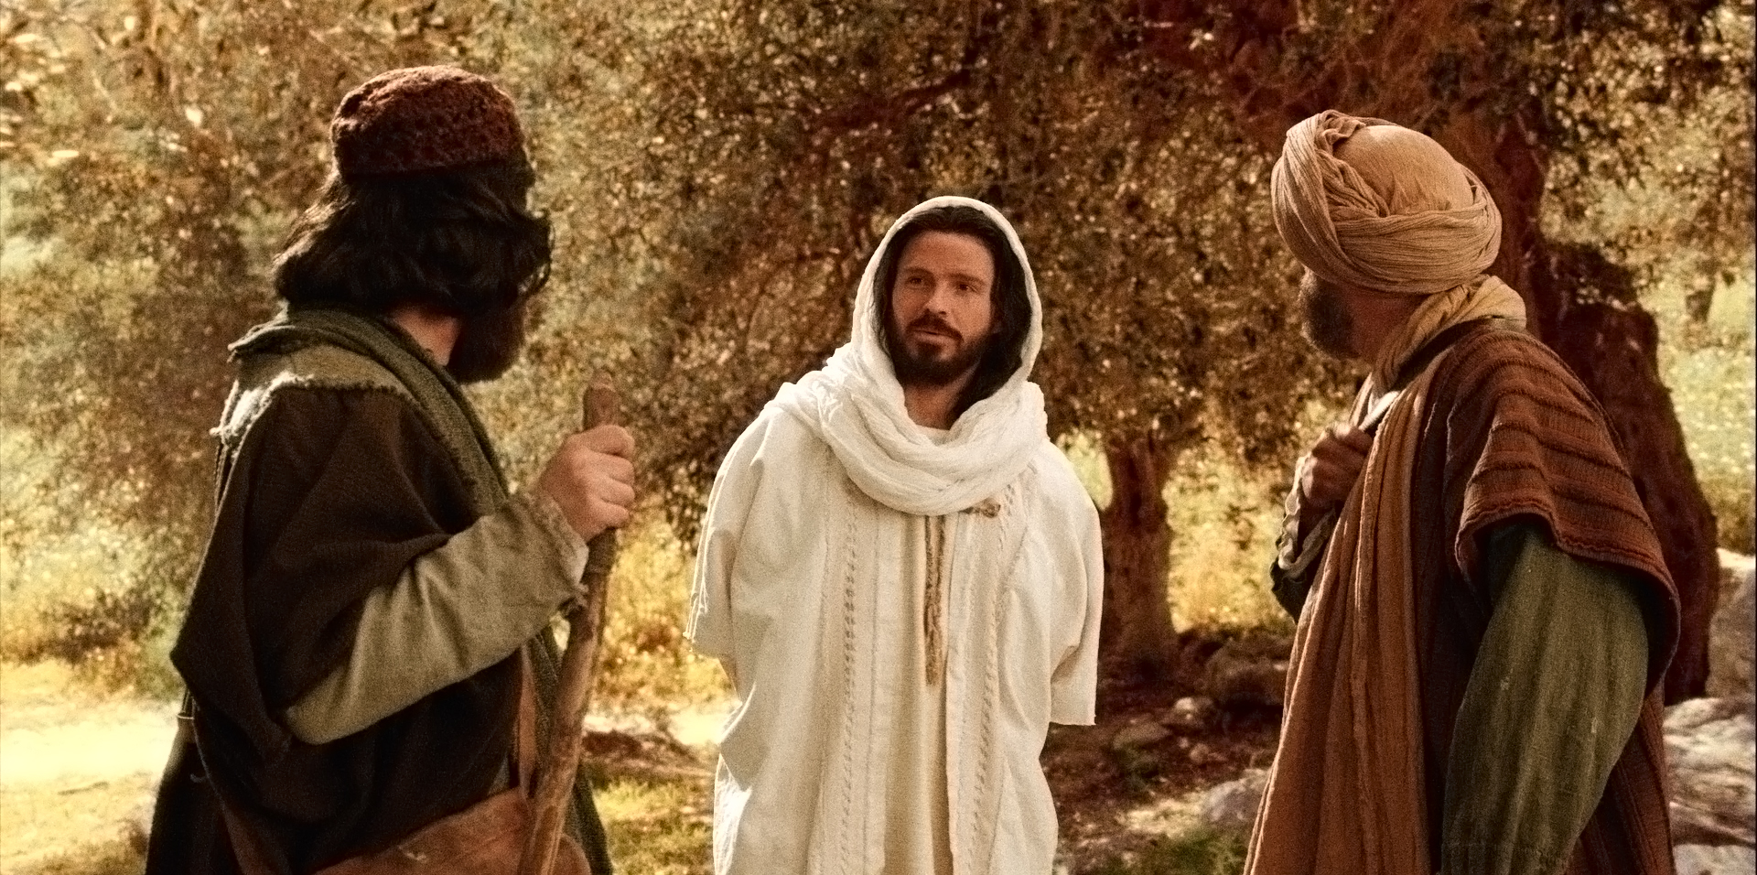
Jesus is Risen Indeed!

Slide 2
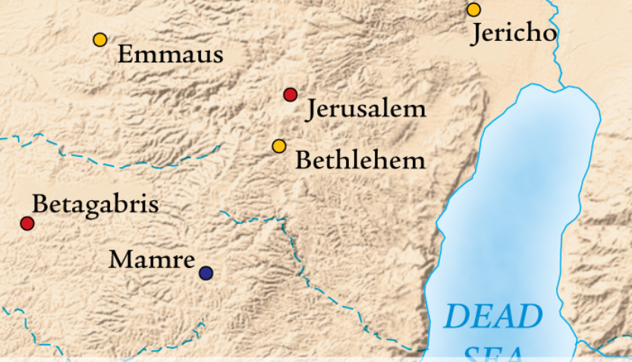
Jerusalem to Emmaus

Slide 3
The Discouragement of a Confused Heart
The cause of their disappointment and doubt was a lack of understanding
When we get confused; when we don’t understand the Word of God, it leads to discouragement

Slide 4
The Discovery of a Challenged Heart
He sought them
He caught them
He taught them
There are 2 things the Lord has to open to us when we’re confused and discouraged:
He has to open the Scriptures
He has to open our eyes

Slide 5
Why didn’t they Recognize Jesus?
He wanted them to recognize Him in the Word of God
Jesus can be found in ALL of the Scriptures
You will never know true joy apart from Jesus, and you will never know Jesus apart from the Scriptures

Slide 6
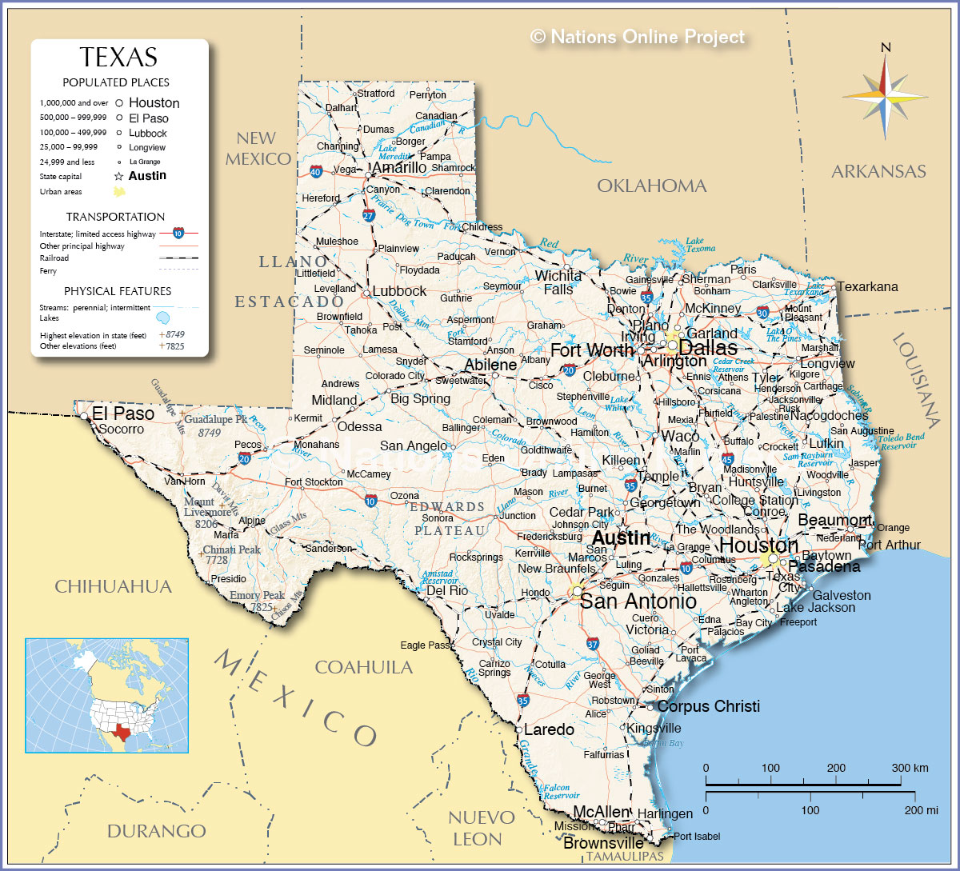

Slide 7
The Declaration of a Convinced Heart
When it seems like the Lord is trying to get away from us, He is testing our faith and our dedication to Him
The Disciples came to a new conclusion:
JESUS IS RISEN INDEED!

