Slide 1
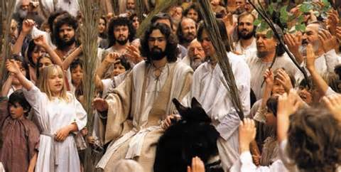
Palm Sunday

Slide 2
Why is Passion Week so Important?
It gives us Assurance of our Salvation
Knowing the truth from God’s Word makes us better witnesses

Slide 3
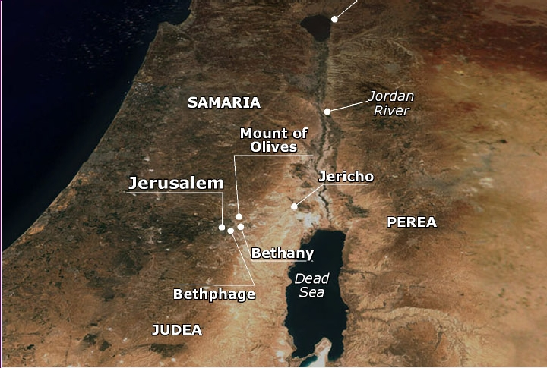
Bethphage and Bethany

Slide 4
Entering Jerusalem
Jesus’ entry fulfills Zech. 9:9
Hosanna means “Save Now”
The Jews wanted deliverance from the Roman Government

Slide 5
“Cleansing” the Temple
The Passover Lamb pointed to the Coming Savior
The merchants had turned the temple into a “Den of Thieves”
Jesus healed the blind, lame, and sick

Slide 6
Teaching in the Temple
His parables insulted the religious leaders
He condemns them as “blind guides” and “broods of vipers”
The Pharisees wanted to kill Lazarus as well as Jesus

Slide 7
Judas makes a deal
Satan “enters” Judas Iscariot
He agrees to betray Jesus
He is paid 30 pieces of silver

Slide 8
The Passover Meal
This was the night of the 1st “Lord’s Supper”
Jesus declares one of the 12 would betray Him
Judas prepares to betray Jesus

Slide 9
In the Garden
Jesus prays while the apostles sleep
Jesus is betrayed with a kiss
Peter tries to defend Jesus

Slide 10
Jesus is Arrested
He tells Peter to put away his sword
Jesus heals Malchus’ ear
Jesus is bound and led away

Slide 11
To Be Continued…

